Slide 1
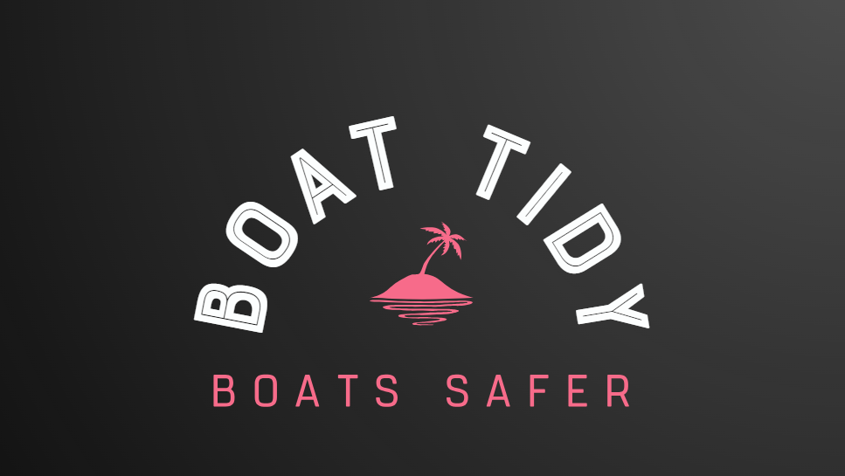

Slide 2
Investigation of context
Context 1 Climate Change: recycling bins where when you recycle a bottle you can vote on famous topics such as sports games or movies this will help people want to get involved in recycling especially if they are passionate in the topic.
Context 2 Playing Games: people getting bored on chairlifts can be dangerous as when people try to play games with friends, they may fall off.to prevent this we have made a screen that comes up from the side of the chair to keep company.
Context 3 Securing or storing personal possessions: This context really appeals me as I have a lot of personal items that need storing and securing in safe places. Sometimes I lose items, and this can be very annoying and frustrating.
Storing and securing my PC equipment so my younger siblings don’t take and use them.
My football boots and accessories are an issue in my bedroom and need to be stored better. This is a problem as they look messy, and my mum gets upset.
Manufacturing and material: the product will be made out of plastic and the storage will be made from leather. To secure to the deck suction cups will be used made from polyurethane. To release the suction cup you must pull the tab to let the air in an pull up slowly.
Shape and size:these come in different sizes based on what the customer is looking for and the shape is made for items to fit into it.
Quality:all of the products will be very durable and high quality so that it can be stable and sturdy
Context 3: Securing or storing personal possesions
I really like smelling good and I have a lot of perfume. A problem I have is that other family members try and use it a lot.
When I go on my dads boat my wallet and phone slide around a lot on the deck and sometimes fall off and get damaged.
Function:this can store all types of items (phones & wallets) depending on the products and can also be used on other vehicles like golf carts and trucks.
Securing or storing items on a boat.
Aesthetic:this comes in many different colors and designs depending on the client's requirement.
Cost this will cost around 10 dollars depending on the design as we use high quality leather and other materials for the suction cups.
I really like being prepared for school and having all my books and equipment organized. Especially my pens and pencils. These go missing a lot and I would like a better solution to storing them.
Environment: this will help the environment as all the plastic from the suction cups will be recycled and the leather will be high quality leather from existing products such as bags.
Client: this is targeted at anybody who uses boats or vehicles that move at high speed. Ages 16 +
Context Problem: The reason I have chosen this problem is I go boating regularly on my dad's boat. Items such as my wallet and phone are hard to secure and stop sliding about the deck. This problem I believe is on all boats as these expensive items and can be costly to replace if lost or broken.
Possible Solution: A product that stick to surfaces on boast to secure my personal items when the water can be rough and bumpy. The product could be held down using suction cups or clamping around safety bars. Items it should hold are phones , wallets, headphones, keys and medication.
Initial Design Brief: The context I have chosen is securing and storing my personal items, I am going to design and manufacture a product that with solve a key problem that I encounter when on my dads' boat. The products function is to secure hold my personal items such as phone, wallet and air pods when on board the boat so they don’t slide about and get damaged.
Evaluation: From this page I have learnt that context is most appealing to me as this is a key problem I encounter daily with loosing or damaging my personal items. From my analysis I have identified that one of these key areas is on my dads boat when use it at the weekends. Personal items can get damaged or broken very easily when the water is rough. In the past my phone was broken when it slid of and smashed on the floor on the boat..

Slide 3

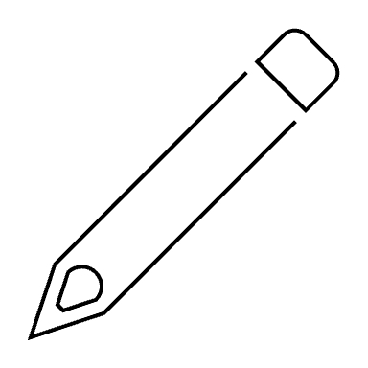

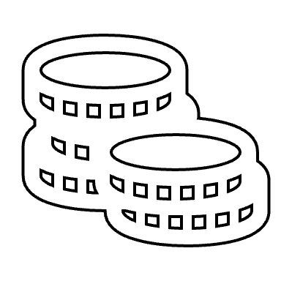
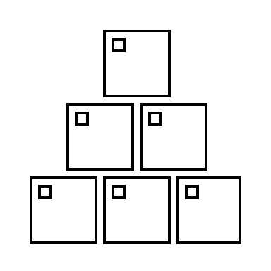
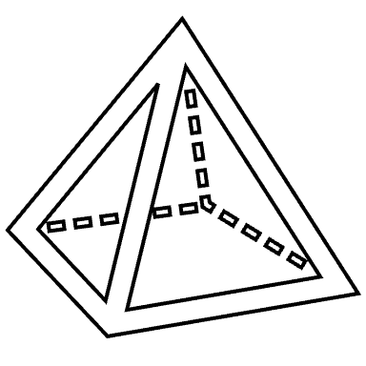
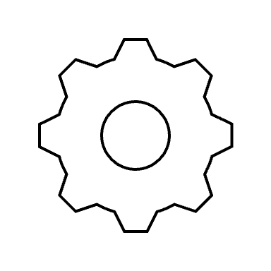
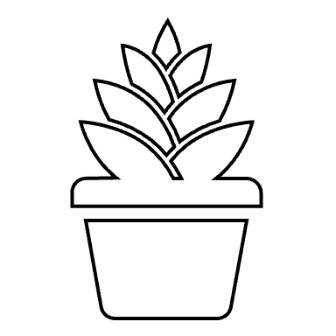
Securing or storing items
I would like for my product to fit the aesthetic of the boat and look like something on a boat or to do with the boat such as a fishing pole. I would like this product to be not too heavy so that it is easily portable yet not too light to the point where wind can move it. I think that generally the colours should be lighter to fit a hot summer day however generally should fit the colours of the boat and it should have a sleek smooth texture to give it a modern look.
(Context 2) Playing Games: people getting bored on chairlifts can be dangerous as when people try to play games with friends, they may fall off.to prevent this we have made a screen that comes up from the side of the chair to keep company.
This product would be very safe as It would not fall out of place and none of the items it is holding would fall out of place even in choppy waters. This would also be shatter proof so if someone did happen to drop it they would be safe from sharp material. We have also considered giving the corners of this shape smooth edges so that no one could hit and hurt themselves on a corner.
I hope that my product will be affordable enough to all however still be high quality I am aiming for a price between 50-75 AED. Although these prices may seem high to some I think that it is justified by the fact that we will be trying to use recycled materials which will cost a lot of money to clean and sort and those factories will be expensive.
Safe
Aesthetics
This product is aimed at people between the ages of 12-70 and specifically boat owners or people who are on boats often. The product should be able to hold personal items securely and potentially be waterproof to protect the items.
(Context 1) Climate Change: Recycling bins where you recycle a bottle, you can vote on famous topics such as sports games or movies this will help people get involved in this especially if they are passionate in the topic.
Client
Cost
Context 3
Securing or storing personal possessions
This product will most likely be made out of recycled materials and also durable and long lasting material to ensure great quality. Some of these materials could be fishing nets or plastic, I have chosen plastic as it is cheap reusable and durable.
This product should be big enough to store as many items as possible however not get in the way of anyone on board. This product should be at the average persons torso so that it is comfortable to use yet still be a good size
Material
Shape & Size
(Context 3) Securing or storing personal possessions: This context really appeals me as I have a lot of personal items that need storing and securing in safe places. Sometimes I lose items, and this can be very annoying and frustrating.
This product is used to store and organise items on a boat such as fishing gear, confectionary and electronic devices this is made to make fishermen and boat owners lives easier and more practical.
Function
Environment
I would love for this product to be as eco-friendly as possible and possibly be made out of recycled material such as fishing nets, lines and plastic. This product is also very durable and can be used 100 of times before it evan starts to break.

Slide 4

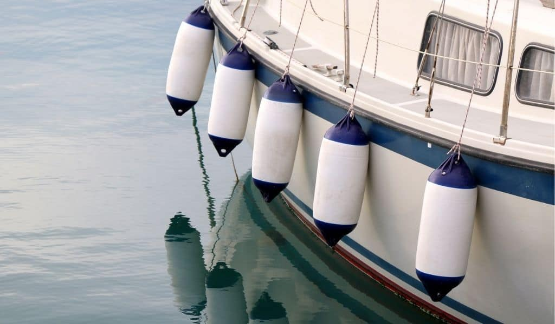
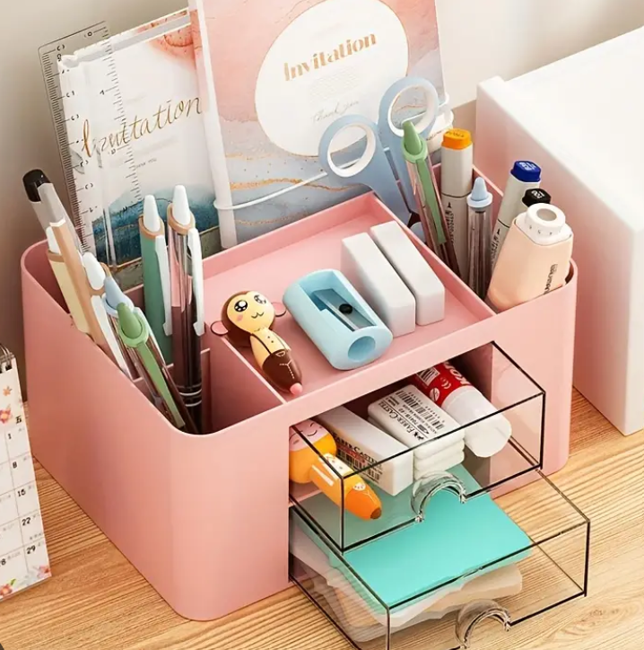
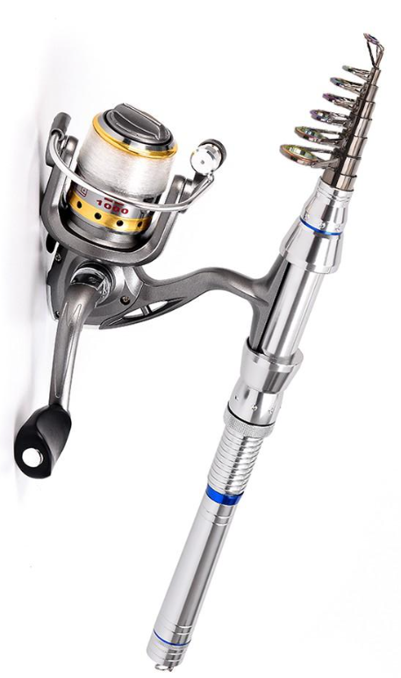
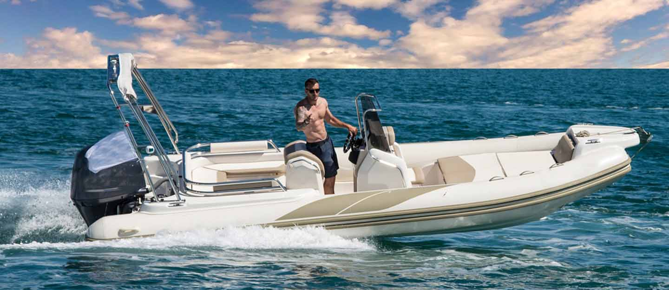
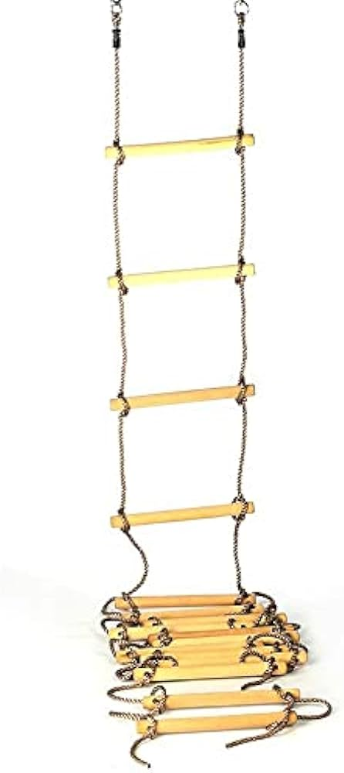
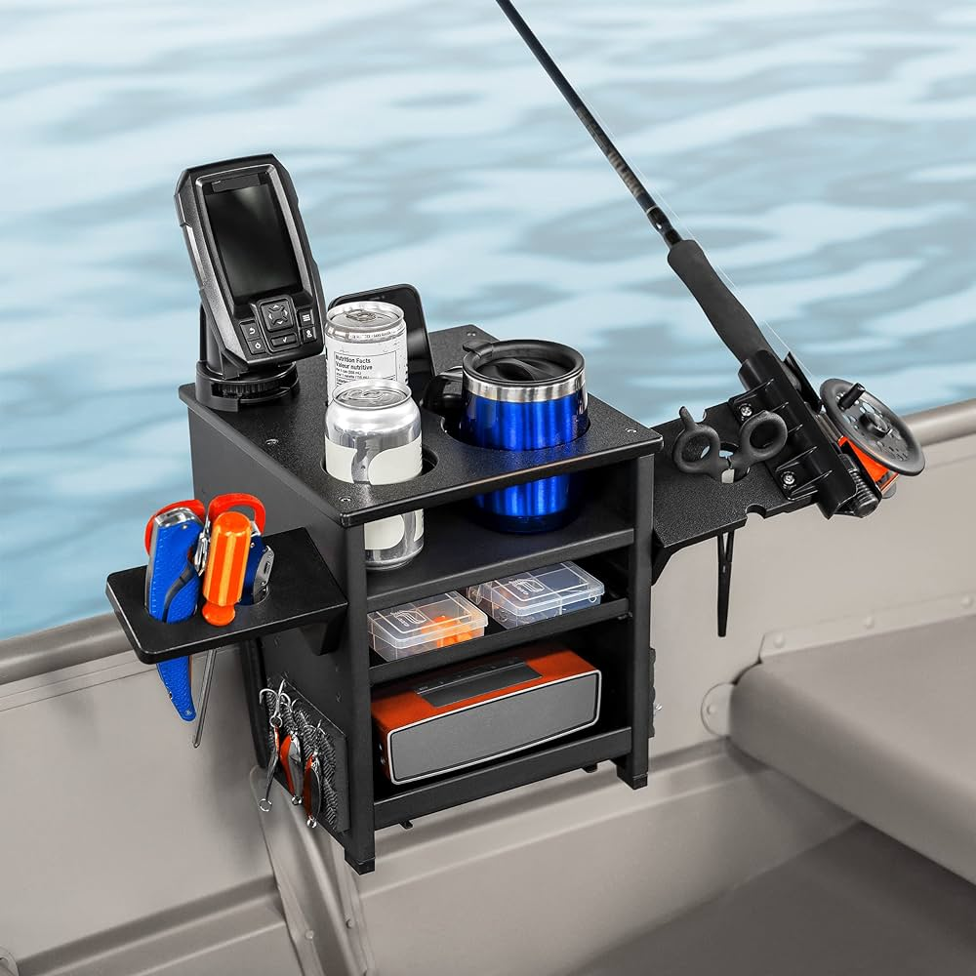
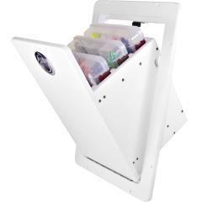
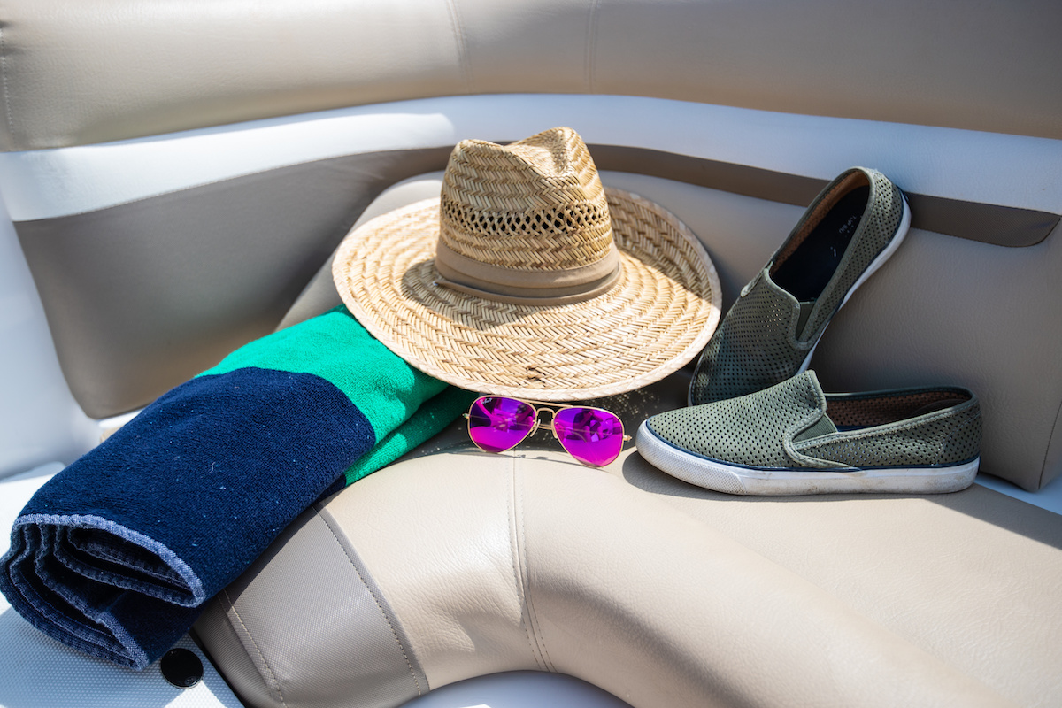
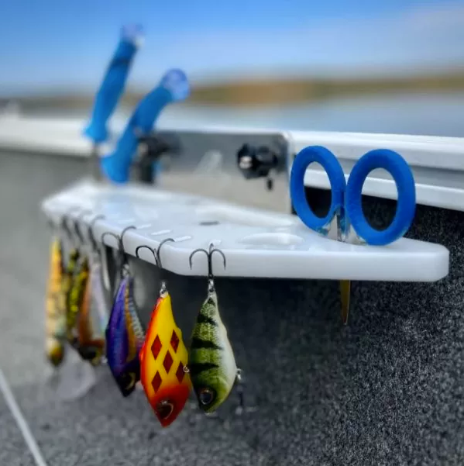
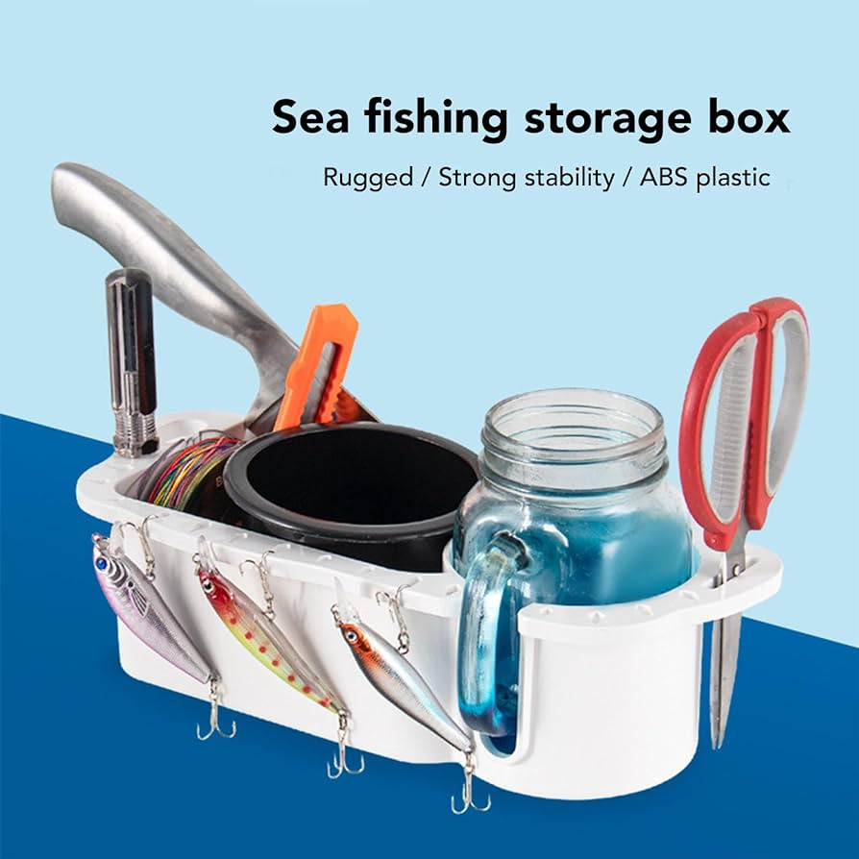
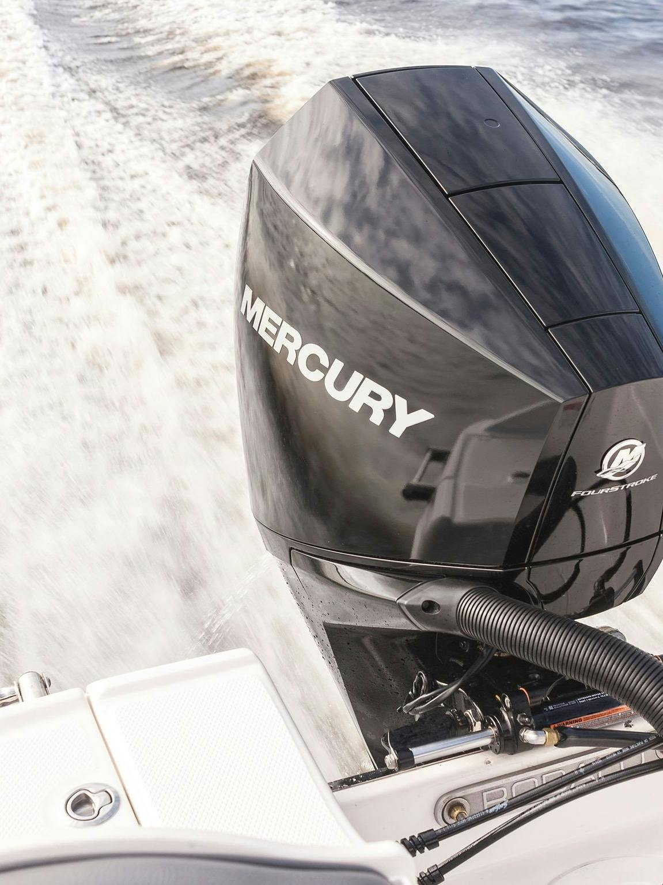
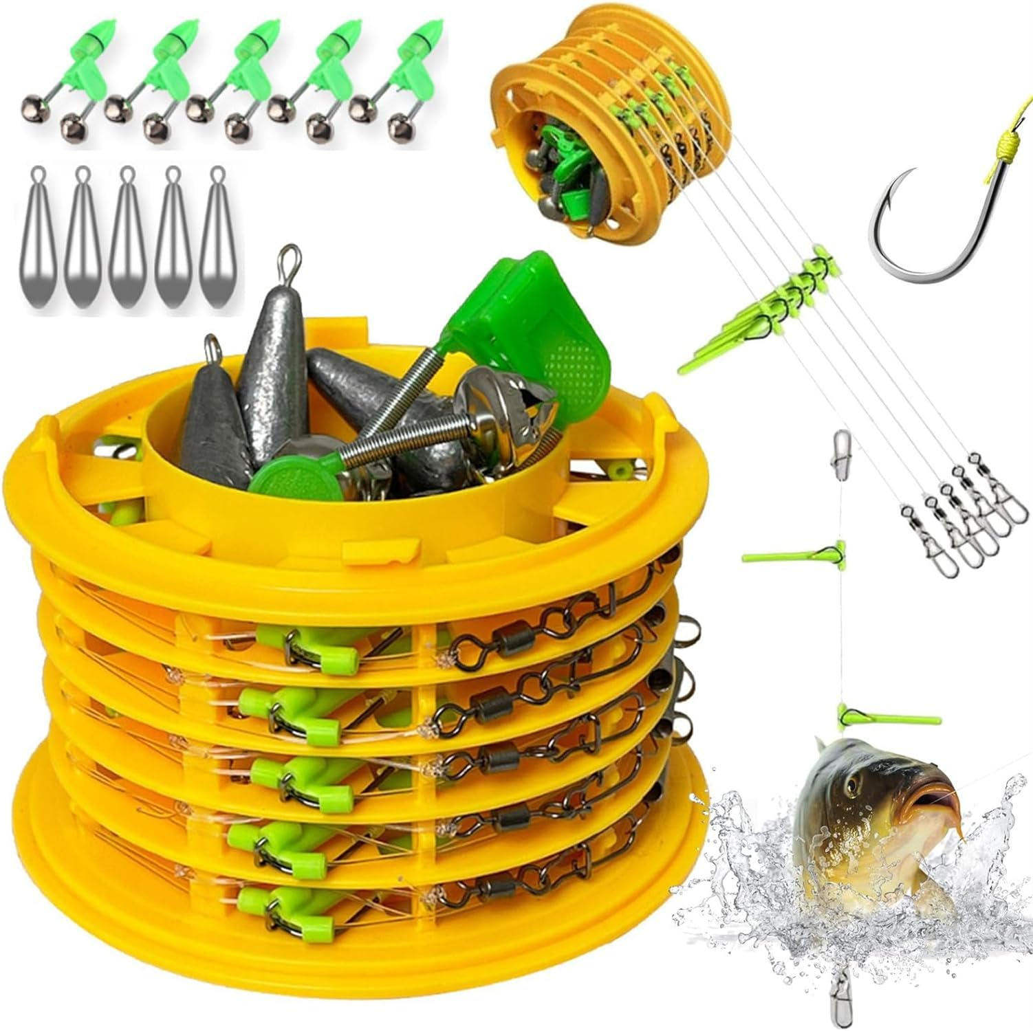
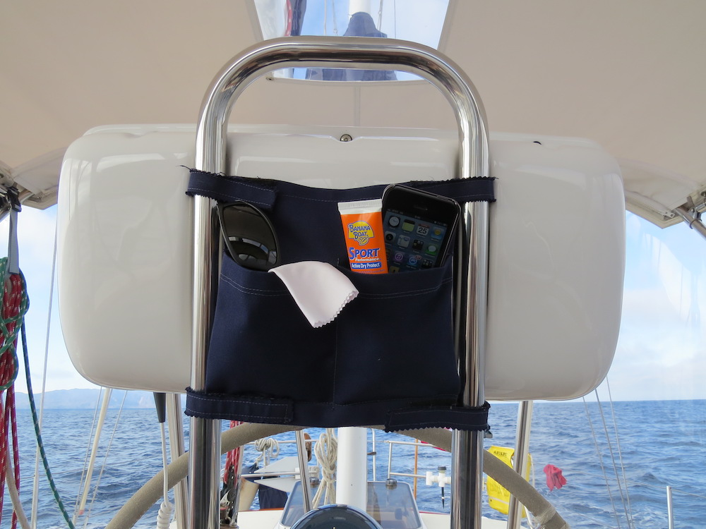
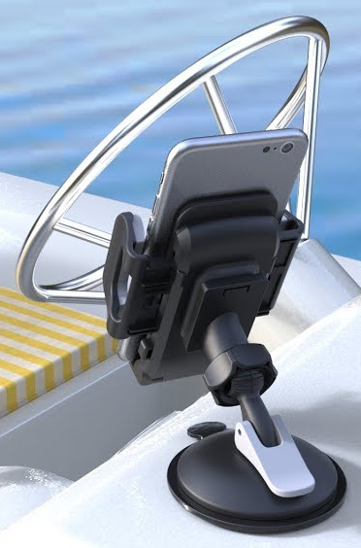

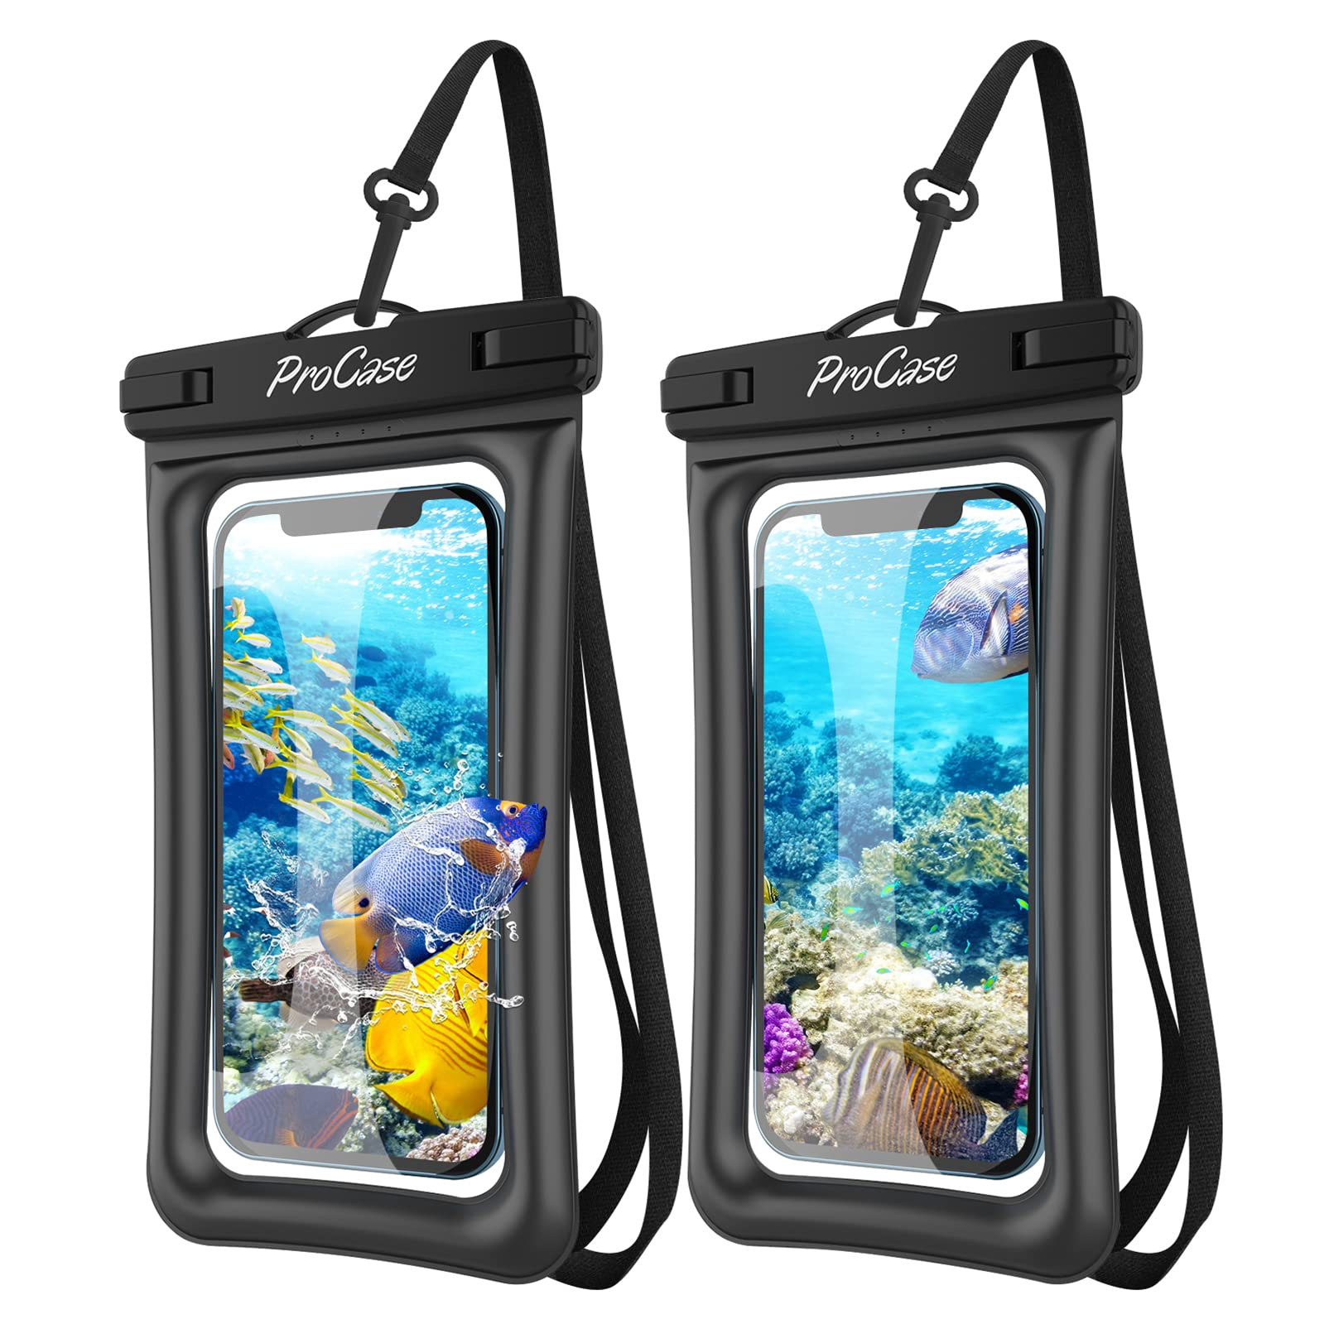
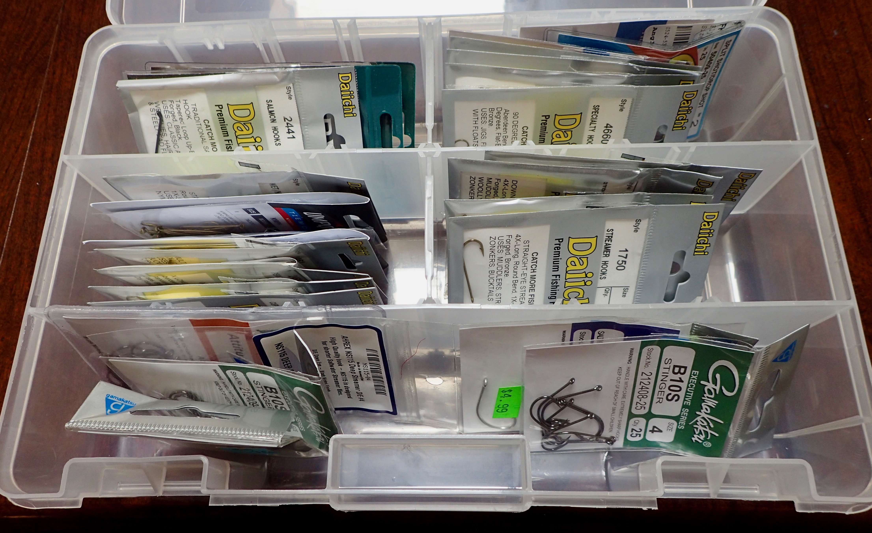
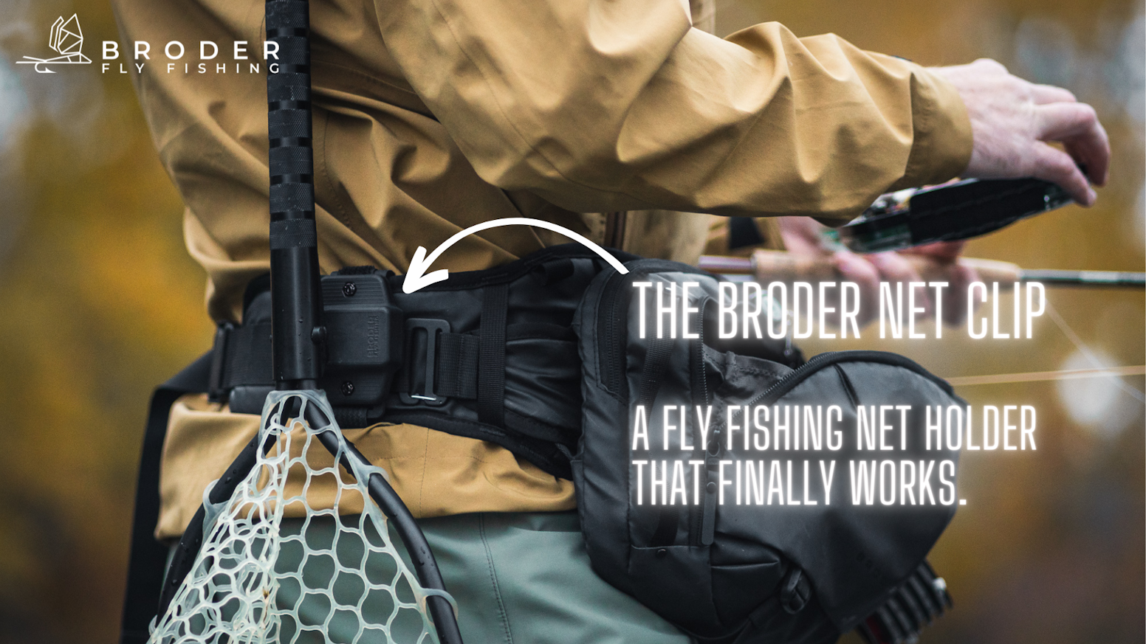
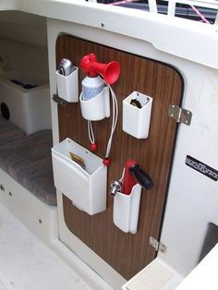
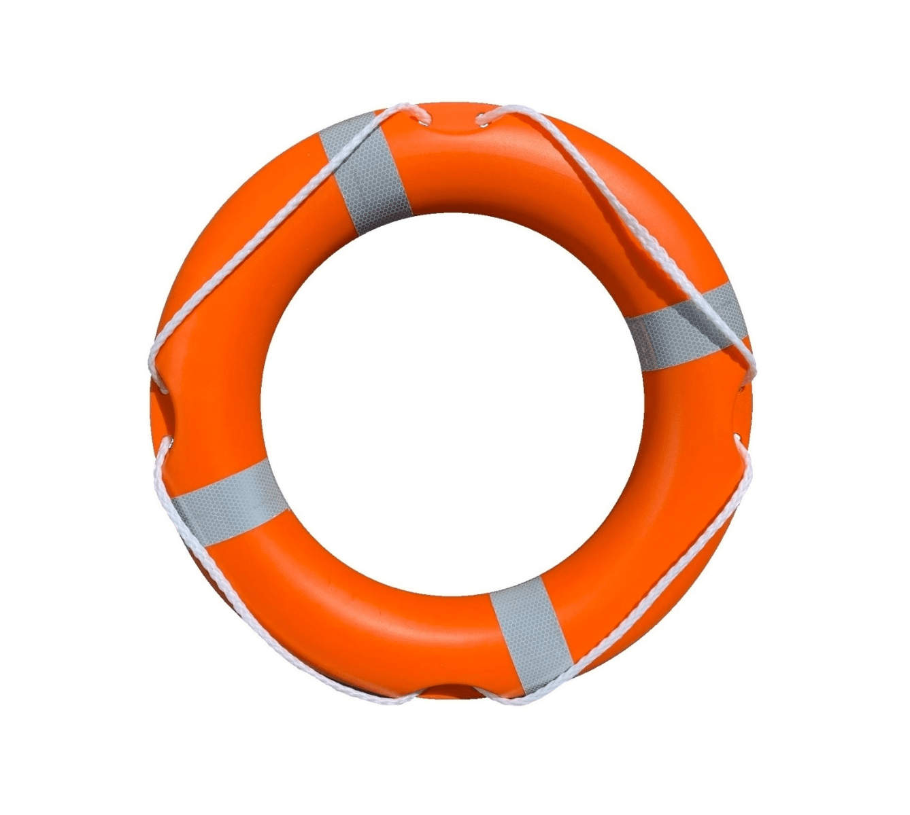
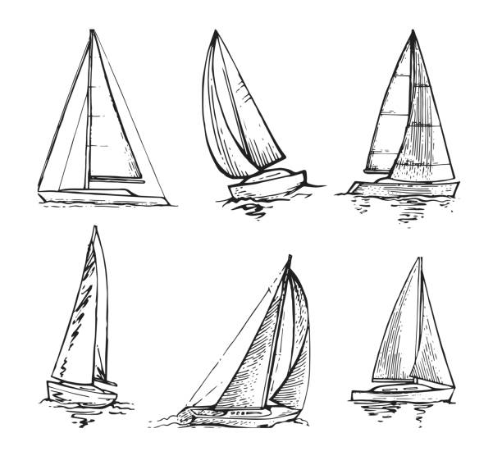
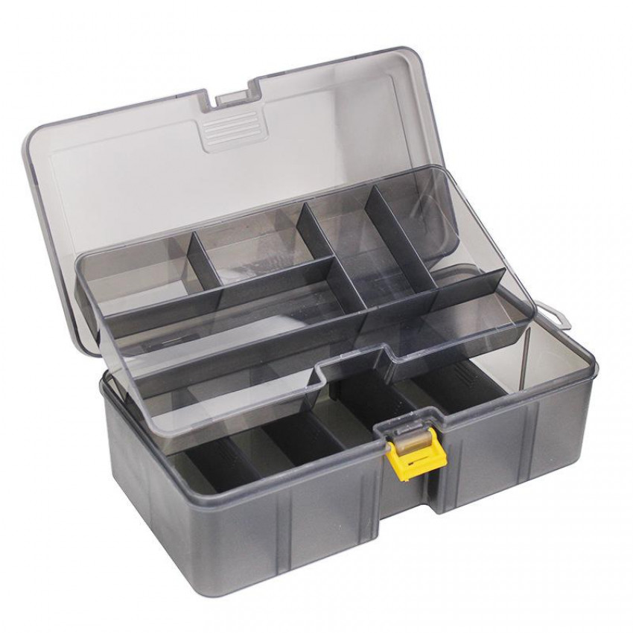
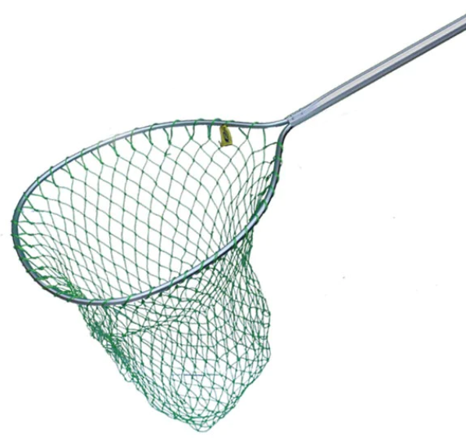
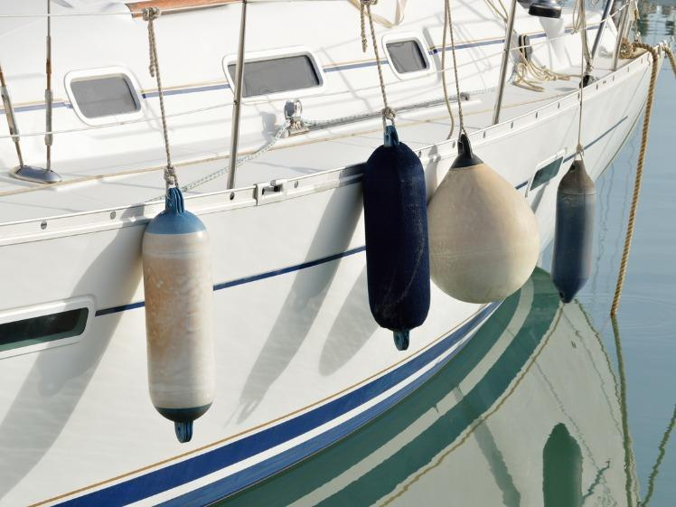
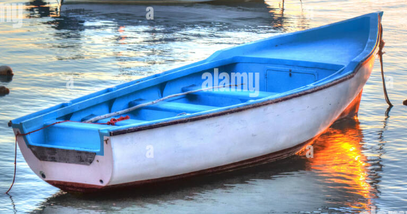
Research plan
Mood board
Research point | Primary | Secondary
The material used | I will test out multiple materials in the workshop to see which ones are most suitable to be used by young children. | https://www.morganscloud.com/2019/05/30/hull-materials-which-is-best/
Skills learned | I will ask people who own boats or yachts what they would like to have on a boat tidy so I can see what to incorporate in my design | https://betterboat.com/blogs/boating/boat-tools
Cost | I will ask boat owners how much they would pay for the product. | https://wwf.panda.org/wwf_news/?10004441/lifetime-cost-plastic
Color | I will ask random people what color they would prefer and based on that offer a range of colorways | What are the colors ranked by popularity? (colorwithleo.com)
Important points | I will compare the size of the product to the boat to check the optimum shape. | Boat Size: Chart, Length Classifications and How to Measure (driveaboatusa.com)
Design | I will look at other similar products and inspire my product off theirs | boat organizer for sale | eBay
Client | Speak with my client regularly to discuss his requirements and his opinion throughout the process.
Initial Specification
Specification Point |  | Justification
Aesthetics | The product should blend in with its surroundings and match the style of the boat, and could also resemble something commonly found on boats e.g. nets, fishing rods, hooks etc. | This is so that the product has a nautical theme and fits the vibe of the boat and doesn’t stick out in a bad way.
Function | The product should be able to store and organize a range of different items securely and practically. | This is so that boat owners and people on boats commonly lives can be made more practical and keep valuable items secure and safe.
Customer | I believe the customer requirements is that the product would have to be safe and made to a high quality. | This ensures that it wont break easily and will be durable and last for a long time.
Size | The product should be able to fit on the boat and be similar scale to proportion to other products. | The product shouldn’t fall out of the boat and get in the way of the crew.
Materials | The product should be made from long lasting material and doesn’t rust/corrode . | This will ensure that the product lasts long and always look good.
Conclusion: from creating the mood board I have collated a range of different products that you would find possibly on a boat or on a marina. I feel having my product link to one of these products would allow it to fit into the environment of a boat and would also complement its surrounding areas.I have created a plan to help develop my idea for the product further we have written further specification that my product has to meet.

Slide 5
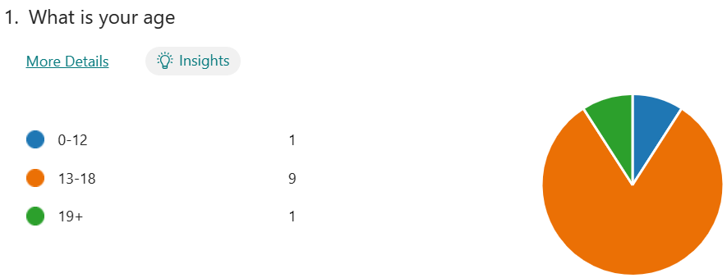
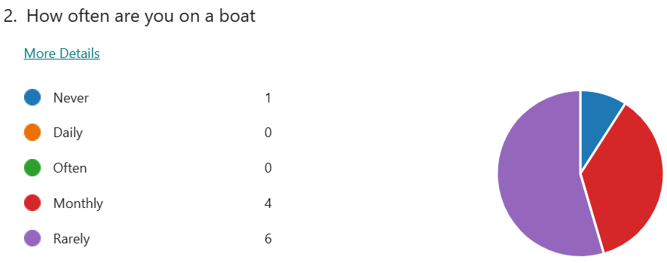
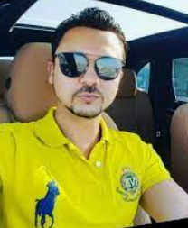
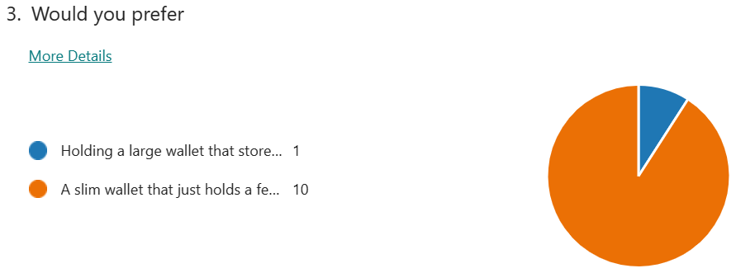
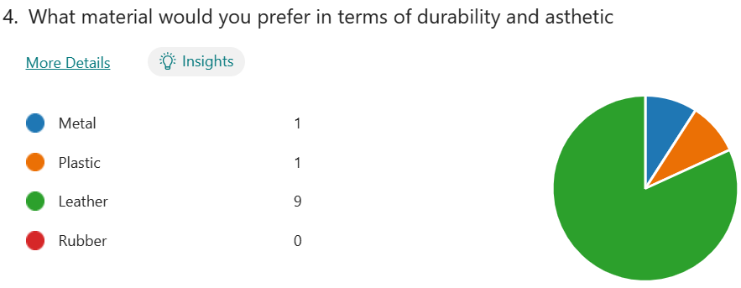
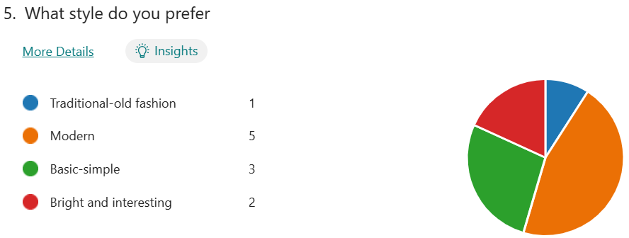
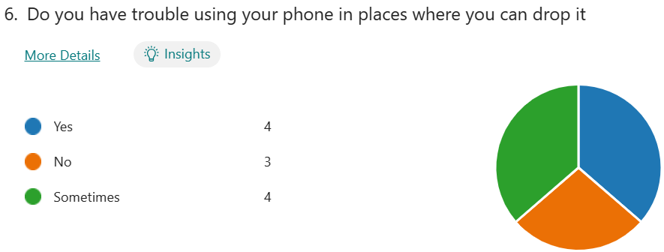
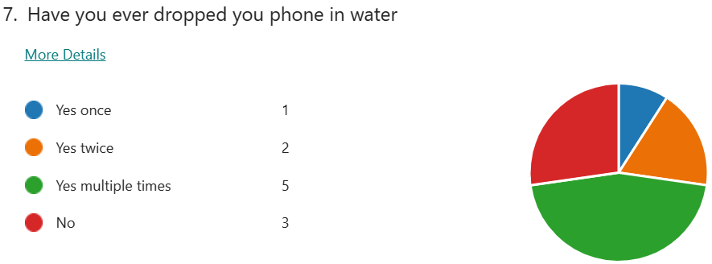
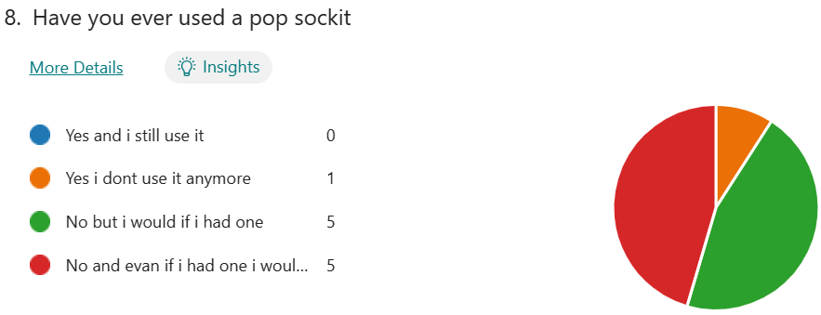
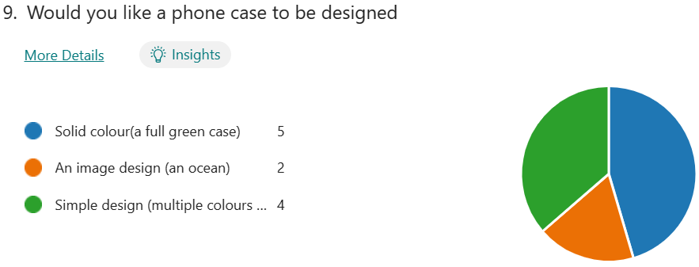
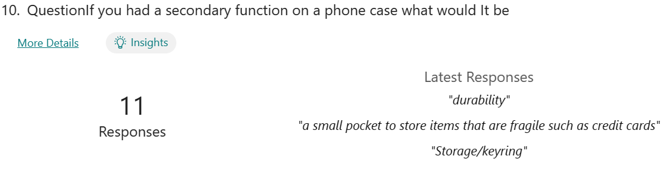
Client Profile Questionnaire
I am going to undertake a client questionnaire, to find a better understanding of what my exactly wants and requirements. This will be hugely beneficial when designing and develop the product. I will also carry out target market questionnaire which give a broader understanding of the requirements of a range of people.
Name: Asad Ali Khawaja
Age: 34
Occupation: Company Owner and CEO at Cozmo Yachts and Boat Rental LLC
Hobbies: Sailing / Fishing / kayaking / Golfing
Address: Dubai Marina, UAE
How often are you on a boat?
Twice a week (weekends)
2. Would you prefer a larger item holder or small?
A product that isn’t that big but holds many items
3. What material would you prefer in terms of durability and aesthetics?
I would like the product to be made out of a type of plastic so that it is long lasting
4. What style do you prefer?
A very simple style
5. Do you have trouble using your phone in places where you can drop it?
Yes, because I get worried, I will break it
6. Have you ever dropped you phone in water?
Yes, I have
7. Have you ever used a popsockit?
Yes, I have used one
8. Would you like a product to be designed like your boat?
Yes, I would like the product to blend in with the boats style
9. If you had a secondary function on the product, what would it be?
I would like it to have a drink holder because I spill my drink a lot on board
10. What is your favorite brand?
Moncler
11. Where would you like the storage product to used?
I would like it to be used near the control station
12. Is there any other items you would like it to hold?
Car keys and my wallet securely
Findings and conclusion:
The survey results have illuminated important preferences among participants, indicating a strong inclination toward plastic materials and modern aesthetics for phone cases. Moreover ,many people said that they have indeed dropped there phone in water this solidifies the need importance of phone keeping your phone safe around water. The desire for a convenient card holder at the back underscores the importance of combining style with practicality in phone case development. These insights provide valuable guidance for creating user-centric phone accessories.

Slide 6
Client consultant
Date | Disscusion | Result | Decision | Next meeting
29/09/2024 | I met with my client to discuss about requirement and specification | From this meeting I established that It should be aesthetically pleasing while still maximizing practicality and quality | I have a good Idea of what the product should look like so I will research existing products which will form my primary and secondary research. | 16/10/2024
16/10/2024 | I met with my client to ask him some questions to know exactly his what he needed to store and how he would like that done. | My Client highlighted to me what he needed to store which then allowed me to further research. | This has made it easier to research and plan ahead with what further research needs completing. | 10/11/2024
10/11/2024 | I met with my client to discuss further what his requirements were regarding his design ideas and what exactly he was looking for. | I asked my client 12 questions that can be seen on the previous slide. | This has given me a grest insight to my client and what he wants. | 05/12/2024
05/12/2024 | I met with my client to show him the 6 designs I completed and to have his opinion on them to further enhance the design process. | The designs were very well received and client really liked number 4 but also considered number 3. | I have decided to go ahead with design 4 as I also feel it is a very good design to further develop. | 25/01/2025
25/01/2025 | I met with my client to show him the final 6 designs so he has seen in total 12 of my designs to decide which one we would like to follow through with. | The designs my client was most attracted to was design number 4 with number 3 and 11 as close seconds. | I have decided to commit to developing design 4 as it was mine and my clients top pick. | 01/02/2025
01/02/2025 | I met with my client to discuss about how to develop my idea and what features to add to make the final design. | We worked a lot out about what we want to add and how we would add it to further develop my design. | We decided to add a tray, backboards , hooks and caps for the nets onto my design. | 15/02/2025
15/02/2025 | I showed my client the finished and developed final design to talk about how to manufacture it. | My client really liked how the final design looked and we had a good talk about how we would produce it. | We will use a range of different methods and materials for the production of it including using :cutting wood, 3D printing | 07/03/2025
07/03/2025 | Should the product be manufactured using more traditional hand tools or automated methods such as 3D printing and laser cutting. | Due to time constraints and the level of energy required we opted to use more modern methods e.g. CNC routers | I will now create the file on 2D design and other CAD softwares and transport it to the machine to begin manufacturing. | 12/03/2025
12/03/2025 | With my client I discussed different finishes that could be applied to the product. The main reason for this was to make the product more durable to withstand the conditions at sea. | Me and my client looked at multiple different finishes such as furnish, spray paint and lacor and explored them deeply. | Overall, we decided to finish the product with polyurethane as we believed it was the most suitable for our product. | 28/03/2025
28/03/2025 | Me and my client went on a fishing day and tested the product out on his boat and discussed the overall positive and negatives. | Although my client liked the functionality of the product he commented in particular in the aesthetic stating that the colour didn’t match the aesthetic. | We decided to plan on the improvements of the product and to develop it further. We did this by changing the colour.

Slide 7
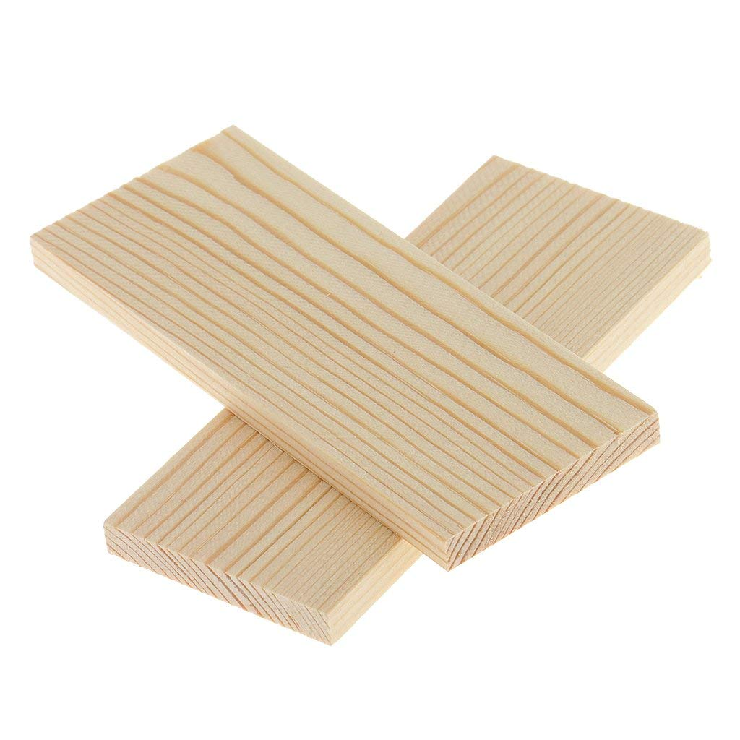
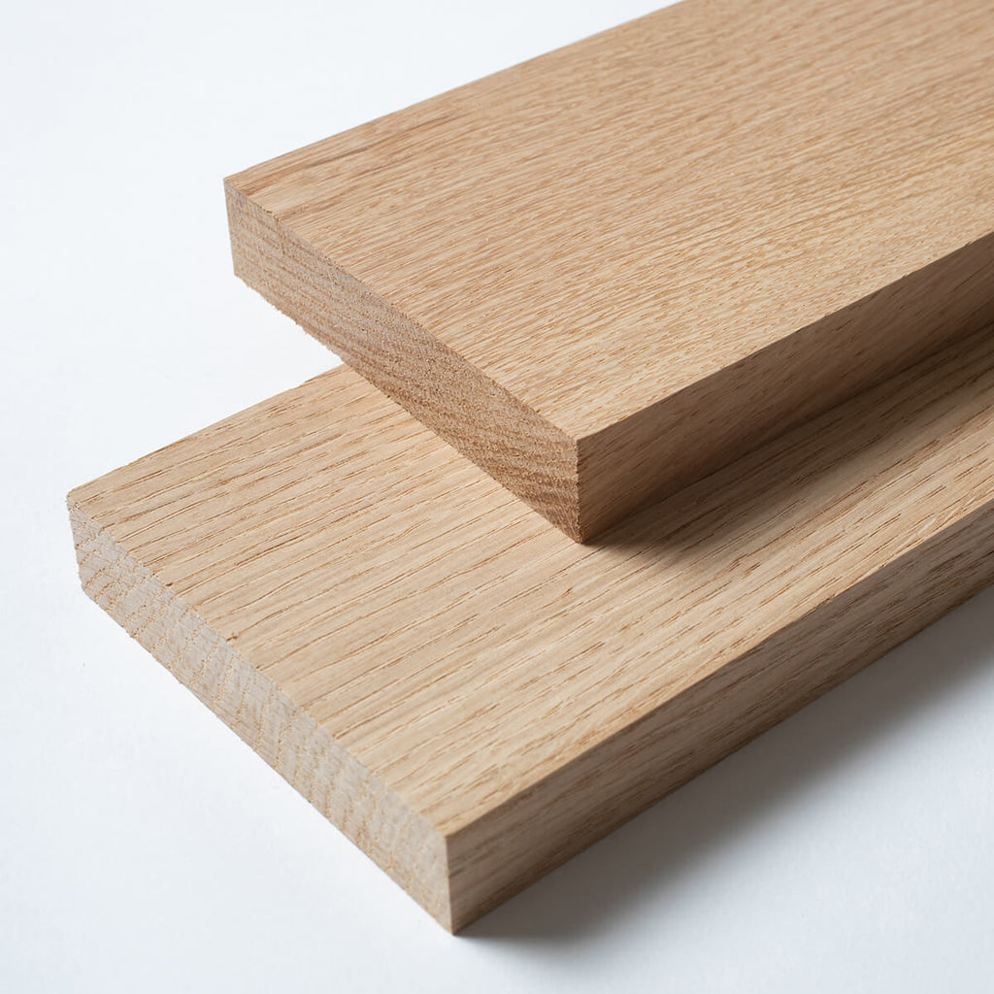
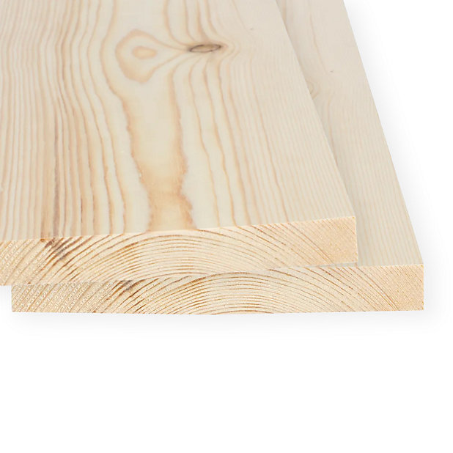
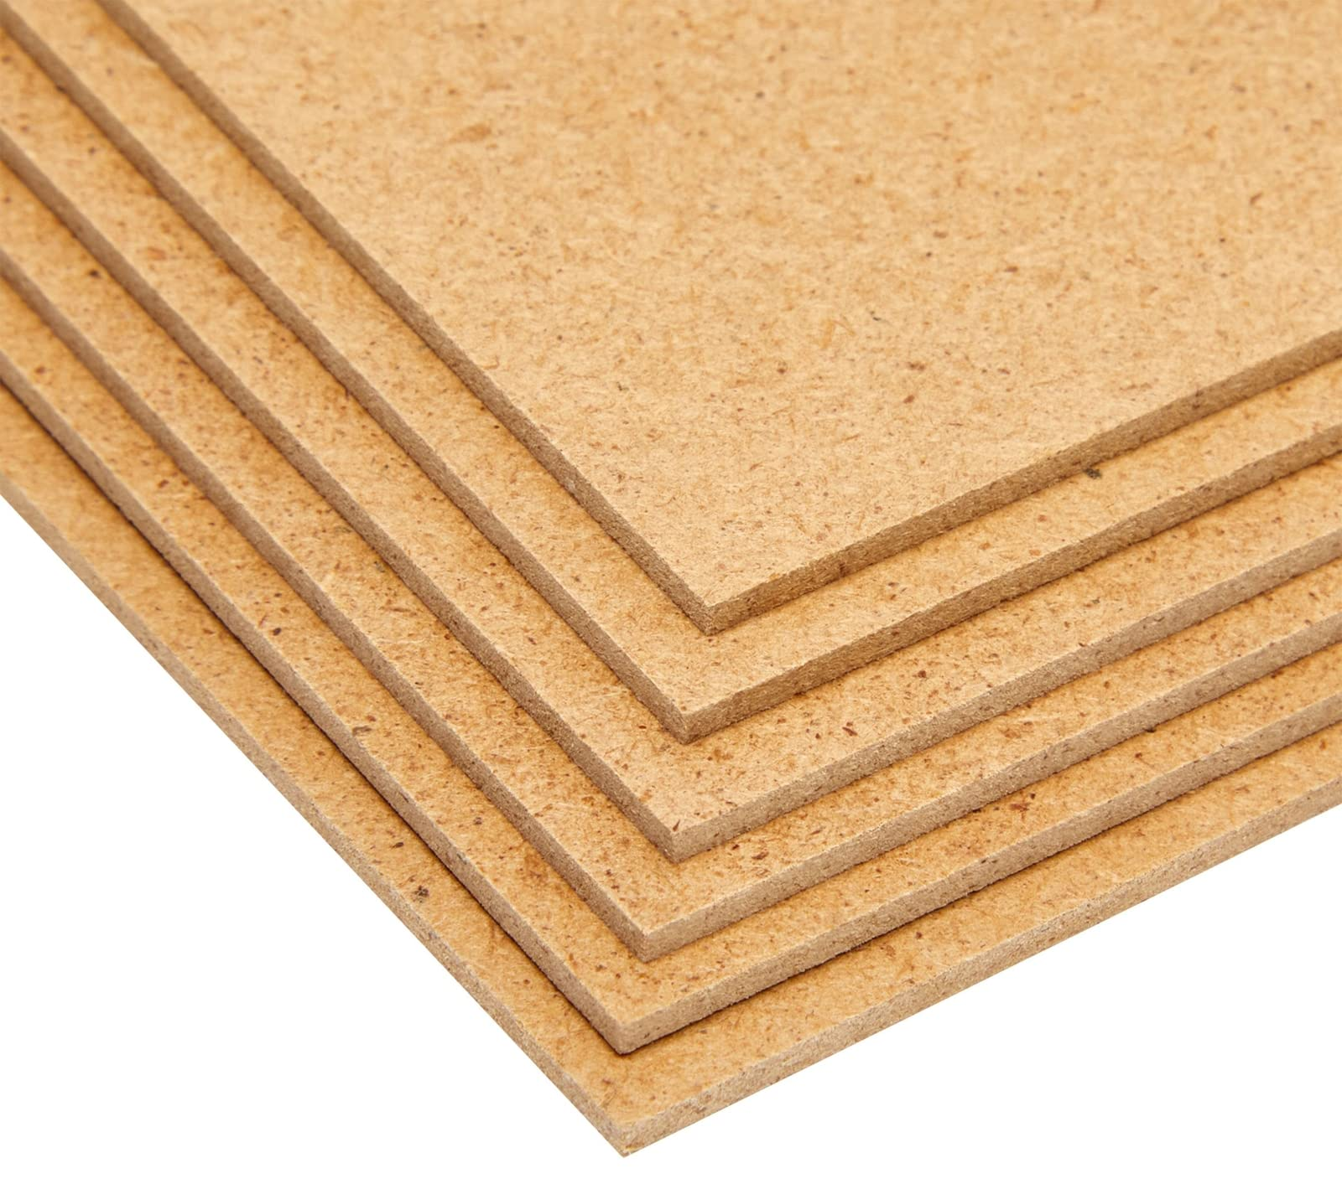
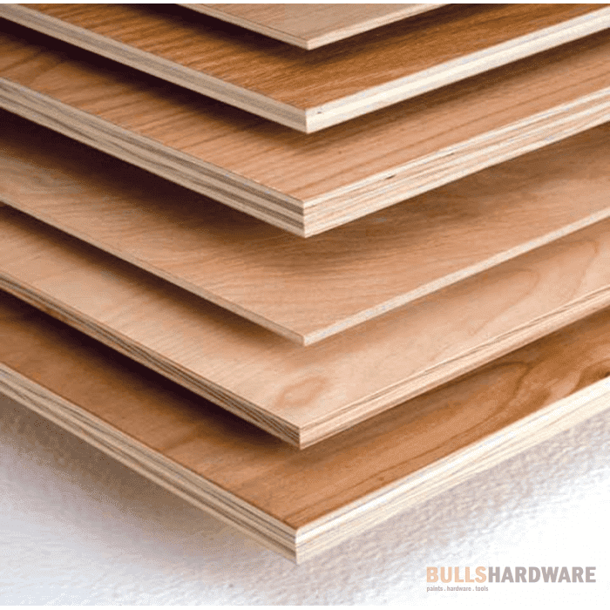
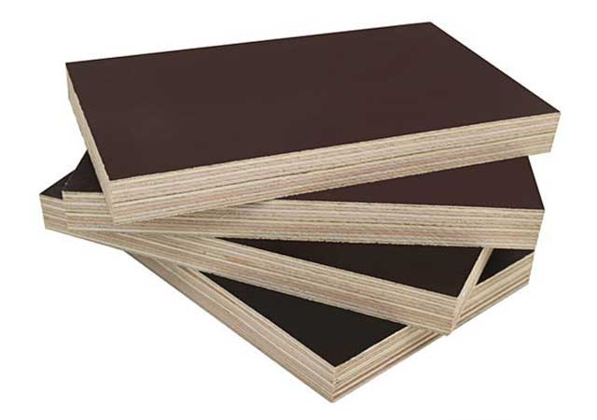
Natural & Manufactured Wood Research
Type of wood?
Soft wood/ Pine
Available in school?
Yes but in limited amounts due to living in a desert.
What are common uses?
structural timber, flooring, furniture, toys, poles, sleepers, posts, landscaping, mining timbers, lining
Is it expensive?
No, it is one of the most affordable types of wood on the market
What rating?
7/10
Conclusion?
Pine would is durable so it wouldn’t be a bad option however it isn’t waterproof so it is not suitable for boats
Type of wood?
Hardwood/ Oak
Available in school?
Very limited amounts available.
What are common uses? furniture, joinery, flooring, panelling, decking and veneers.
Is it expensive?
Yes oak can be expensive to buy.
What rating?
6/10
Conclusion?
Oak would is water resistant but it is expensive and would be hard to find and there is better options.
Type of wood?
Soft wood/ Spruce
Available in school?
Very limited amount available as rarely used in school.
What are common uses? paper pulp, furniture, construction, lumber, crates and boxes, millwork, and soundboards for musical instruments.
Is it expensive?
Spruce is relatively inexpensive to buy.
What rating?
6/10
Conclusion?
Spruce would be difficult to find in school and isn’t suitable for outdoors.
Type of wood?
Manufactured board / MDF
Available in school?
Yes, Widely available and used a lot in school.
What are common uses? manufacturing of furniture, kitchen cabinets, moldings, millwork, door parts, and laminate flooring.
Is it expensive?
No, MDF is a cheaper alternative to solid wood
What rating?
7/10
Conclusion?
Although MDF would be easily accessible it is not suitable for wet environments at all.
Type of wood?
Manufactured board / Ply wood
Available in school?
Yes, available in lots of different sizes in school.
What are common uses?
sub-flooring, single-layer flooring, wall, roof and floor sheathing, structural insulated panels.
Is it expensive?
No, it is relatively cheaper than hardwood boards
What rating?
7/10
Conclusion?
Ply wood is very easily accessible in school and durable it isn’t very waterproof..
Type of wood?
Manufactured board / Marine ply wood
Available in school?
No, not available in school and will need to be sourced else where.
What are common uses?
Boats, Docks, kitchens, bathrooms, decking and exterior furniture.
Is it expensive?
Yes, marine plywood may be relatively expensive
What rating?
8/10
Conclusion?
Not only is marine ply extremely durable and long lasting but it is also very waterproof and suitable for boats.

Slide 8
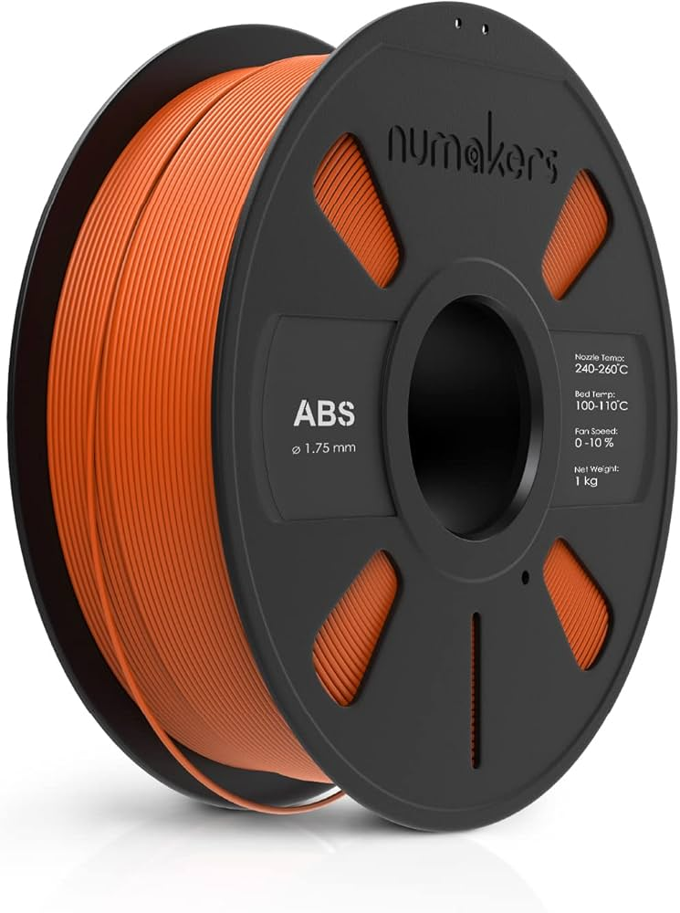
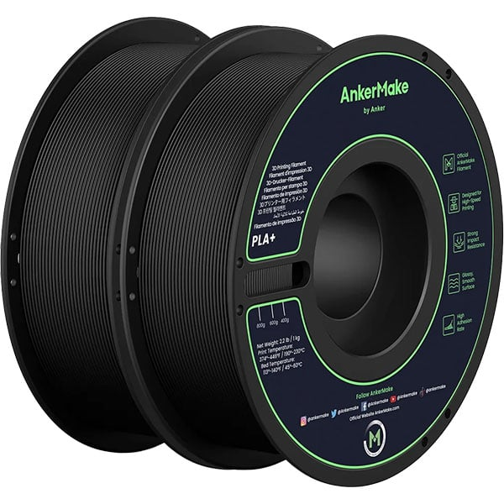





Plastic Material Research
3D printing filament:
Acrylonitrile Butadiene Styrene (ABS) VS Polylactic Acid (PLA)
Accessibility in school
PLA is generally more accessible in school than ABS and comes in a wider range of colours.
strength
ABS is a stronger and more durable material whereas PLA can usually be brittle.
Melting point
ABS has a melting point around 200C whereas PLAs melting point is at 173C which are both very high.
Biodegradable?
ABS is not biodegradable however PLA can be biodegradable under the right conditions making it more environmentally friendly.
Price
They are both around the same price point which is roughly 20 USD per kilo.
Common products
ABS is used for LEGO and electronic housing while PLA is used for cups, plastic bags, and cutlery
Rating: PLA(8/10) ABS(7/10)
Type of plastic?
Acrylic
Available in school?
Yes, very widely available in many different colors
What are common uses?
lenses, acrylic nails, and paint to medical devices, furniture, and LCD screens
Is it expensive?
Acrylic is relatively expensive compared to other plastics.
What rating?
9/10
Conclusion?
This would be a great option for my product as it is widely available and easily accessible at school and comes in a range of colors it is also durable and long lasting.
Type of plastic?
Polypropylene
Available in school?
No I would have to buy it externally.
What are common uses?
Pallets, bottles, jars, yogurt containers, hot beverage cups, and food packaging
Is it expensive?
No it is very cheap.
What rating?
5/10
Conclusion?
This product although cheap is not available in school at all it is also not durable or long lasting . This is not a good fit for my product.
Type of plastic?
High impact polystyrene
Available in school?
Yes this would be easily accessible in school
What are common uses?
Printed graphics, prototypes, shelves, kiosks and fixtures.
Is it expensive?
It is inexpensive.
What rating?
8/10
Conclusion?
This product is a good option for my product as it is accessible in school and comes in a range of colors. However it is not waterproof so it is not the best material for my product.
Type of plastic?
Melamine
Available in school?
No it is not available in school .
What are common uses?
electrical components, household goods, laminates, kitchenware, floor tiles, and fire-resistant fabrics.
Is it expensive?
Melamine is quite affordable.
What rating?
6/10
Conclusion?
Melamine is not easily accessible in school and looks visually unpleasant so this product is not a good option.
Type of plastic?
Polyester resin
Available in school?
Only in very small amounts
What are common uses?
Coasters, decorative tiles, table tops and bathtubs.
Is it expensive?
It is relatively pricey.
What rating?
6/10
Conclusion?
This material is not easily accessible in school and is relatively expensive however it is a good material for water proof products and it is very easy to use.

Slide 9
















Tools and Machines \ Manufacturing Processes
Pillar Drill | Pillar drills are used to make circular holes into material using drill bits you attach to it which come in different shapes and sizes. The material must be securely held down in a vice and wear safety glasses
Hand Drill | Hand drills are a portable and used to make holes into material. They also can use different drill bits to make different sized holes and use batteries for power. You should use safety glasses when using it.
Strip Heater | Strip heaters heat thermoplastic in a straight line to make it mor flexible. You can then bend the plastic to shape it how you would like. you must keep your hands clear of the hot surface of the strip heater.
Vacuum Former | Vacuum formers are used to shape plastic by heating it up then pushing a mold through it. Often the plastic used is Acrylic (PMMA). You should wear heat protective gloves to keep safe.
3D Printer | 3D printers are used to manufacture parts of products which are made out of plastic, often PLA or ABS, You must use CAD to create the design before you 3D print it.
Band facer | A band facer is used to sandpaper off material such as wood. This is done by moving a sandpaper round at a high speed while you hold material to it. You must keep lose clothing away from the band facer.
Laser Cutter | Laser cutters are used to cut out shapes into material. It does this by heating it up and outlining the shape it wants to create. On a laser cutter you should make sue your settings are appropriate.
Steam Bender | Steam benders form and shape woods it does this by placing the wood on a mold then sucking the air out of it so it hugs the mold and forms into the shape of it.
Tri Square | A tri square is used to mark out right angles and straight lines on wood. It is used to ensure accuracy and precision during the marking out stage.
Steel Ruler | steel rulers are used for measuring and making accurate straight lines that are the exact right length during the marking out stage.
Tenon Saw | A tenon saw is a small saw typically with a steel or brass back and is used to cut mortise and straight lines on wood.
Coping Saw | Coping saws are thin blade saws with a large U shaped frame usually use to cut curved edges on wood or plastic.
Chisel | Chisels are sharp tools used for shaving or carving wood off typically used for wood joints. This can be dangerous as you could cut yourself.
Fret Saw | This is an electrical saw used to cut thin cuts into wood and to create carved edges. These saws are very sharp and may cut you.
Bench Vice | Bench vices are use to secure material while working on them on a bench, this enables material to be held firmly and securely when being cut or worked on.
G Clamp | A G clamp is used for clamping material together usually when joining wood. You must make sure to not tighten it to much to prevent harm to material.

Slide 10








Assembly Method Research
Type of assembly method?
Knock down fittings
What are common uses?
It is used a lot with flatpack furniture such as IKEA because it is very strong and holds materials together
How strong/durable is this method?
Extremely strong and can be adjusted accordingly
Suitable material?
Used a lot with wooden materials or manufactured boards.
Conclusion?
Extremely cheap , easily available and is perfect for quick assembly.
Type of assembly method?
Screw fixings
What are common uses?
For assembling multiple different types of materials used in a wide range of products.
How strong/durable is this method?
Extremely strong and durable as they come in a range of sizes
Suitable material?
Can be used across a variety of materials such as wood plastics and metals.
Conclusion?
It is widely available, relatively cheap and very strong and is a great method to join material
Type of assembly method?
Mortise and tenon joint
What are common uses?
Mostly furniture for example Windows, beds, chairs, and tables
How strong/durable is this method?
It is an extremely strong wood joint if manufactured properly it also has a large contact surface area where adhesive can be applied.
Suitable material?
Mainly used for wood but can also be used for plastic bar.
Conclusion?
It is a very good assembly method as it is relatively easy to manufacture and is very strong.
.
Type of assembly method?
Dowel joint
What are common uses?
Furniture, Cabinets ,Staircases and shelving.
How strong/durable is this method?
Dowel joints are very strong and use ridges in the side of the dowel to make more surface area for adhesive.
Suitable material?
Woods
Conclusion?
.It is a very easy to manufacture and can be very strong if the holes are made accurately and fit securely.
Type of assembly method?
Finger/comb joint
What are common uses?
Drawers, wood chests , jewelry and acrylic boxes.
How strong/durable is this method?
Can be very strong if manufactured it can be very tight you also have a large surface area to add adhesive to.
Suitable material?
Woods and acrylic
Conclusion?
.Can be a very useful joint manufactured by hand or by laser cutter and is very practical
Type of assembly method?
PVA wood glue
What are common uses?
Securing different types of wood together or securing different wood joints.
How strong/durable is this method?
It is the strongest wood glue available and is very durable.
Suitable material?
A wide range of woods
Conclusion?
.It is relatively cheap, easily available, strong and can be used on all types of wood so it is a very good adhesive.
Type of assembly method?
Acrylic adhesive
What are common uses?
Assembling plastic components together such as pieces of boxes or other products.
How strong/durable is this method?
It is extremely strong but is very dependent on the size of the contact surface area.
Suitable material?
Mostly just Acrylic and other polymer materials.
Conclusion?
.It is extremely strong and is visually aesthetic because the adhesive is colorless and almost invisible.
Type of assembly method?
Impact adhesive
What are common uses?
Assembling mixed materials such as wood or plastic
How strong/durable is this method?
It can be extremely strong depending on the surface area.
Suitable material?
It can be used on a very wide range of materials which can be very useful.
Conclusion?
.It is very easily available and convenient because it can be used on a range of materials but can be visible and ruin the aesthetic of your product.

Slide 11







Name of finish: Wood varnish
Price: about 50 USD per pint
Advantages: It doesn’t cover the grain of the wood, easy to apply and protects the wood from moisture.
Disadvantages: Varnish can dull or yellow over time and also have air bubbles in it if not applied correctly.
Name of finish: wood Paint.
Price: 30 USD per pint
Advantages: Easy maintenance, gives you a wide range of colors and hides flaws within the wood.
Disadvantages: Paint may trap moisture and it can be very difficult to remove and it can become flaky once it becomes worn out.
Name of finish: Wood wax
Price: 30 USD per pint
Advantages: Wax is a natural source and therefore environmentally friendly and protects the wood using natural oils.
Disadvantages: They can wear off easily and require frequent maintenance.
Name of finish: Lacquer
Price: 25 USD per pint
Advantages: offers a durable, glossy finish that dries quickly and is easy to repair.
Disadvantages: It needs specialized equipment to apply as it can be toxic and is difficult to clean up.
Name of finish: Linseed oil
Price: 20 USD per pint
Advantages: enhancing wood grain, providing natural protection, and being eco-friendly
Disadvantages: Needs frequent maintenance it is susceptible to water rings and may yellow over time
Name of finish: wood stain
Price: 15 USD per pint
Advantages: Gives you options of the aesthetic you want your wood to be while still highlighting the grain of it.
Disadvantages: Doesn’t work very well with all types of wood and can be unpredictable.
Name of finish: Spray paint
Price: 12 USD per can
Advantages: Offers speed and a smooth finish.
Disadvantages: it requires more prep work and can be messy
Finishes
Conclusion: In conclusion, between the 7 finishes that I analyzed. I believe varnish is the most suitable product to apply to wood as it is easy to apply and doesn’t cover the grain of the wood. However, for plastic , if the color I want isn’t available I will plan on using spray painting to color it as it is fast, easy and gives the product a smooth finish.

Slide 12









Introduction: I’ll be using my clients measurements (pictures on the right) as a guideline of my general target audience while still taking into consideration other possible users of my product.
Ergonomics and Anthropometrics
What is anthropometrics?
Anthropometrics is the practice of using measurements of the user within the design of a product.
What is ergonomics?
Ergonomics is the science of using anthropometric data to design a safe and comfortable interaction between the user of the product and the product itself.
Why is ergonomics and anthropometrics important?
Both ergonomics and anthropometrics are crucial in the design of any product weather it is targeted for a adult child, or even a dog. This is because it will allow the user to have an simple and easy use of the product and ensure they are using it correctly. On the other hand, when anthropometrics and ergonomics are not used in design this may lead to injury, discomfort and possibly leading to a large audience completely not being able to use the product.
How will this affect the design of my product?
This will definitely affect my product as I must ensure that all of my target audience and a wide range of ages can use my product safely and correctly, for example making sure kids can reach the top storage unit and the elderly can reach the bottom.
Client primary research: I have measured my clients hands/palm to ensure that his and others hands will fit into even the smallest storage units comfortably. Aswell as that I measured his arm length in many different positions such as sitting, standing , bending over and reaching upwards. This will give me a rough idea of how tall/short the product can and should be
Conclusion: In conclusion, Ergonomics and anthropometrics will play a vital part in the success of my product and I will be taking all of the anthropometric data into consideration when designing my product and considering the scale.

Slide 13



Biomimicry - research
Kangaroo pouch
Kangaroos can use their bodies as storage to hold their off spring I believe that this type of sleek storage is very convenient and practical and could definetely be a part of my design considering one of my products main functions will be to store. It not only can store a lot but also is very hard to spot when the offsprings head is not hanging out. The pouch also keeps the offspring warm which could be a good idea for keeping fish and bait cold and fresh when people go out fishing with my product.
Octopus tentacles
Octopi have very long and flexable tentacles covered in suction cups. These can be used to grab items securely and hook edges to pull themselves closer. I believe incorporating some of these qualities to my product could improve it majorly. For example I could use suction cups to attach items such as phones onto the product directly or I could make hooks which allow things such as speakers and fish gear to be hung on to the product
Ocean Wildlife
I definitely would like to take inspiration from nature and more specifically the ocean in my design such as shapes like the silhouette of a fish , aquatic plants and other ocean themed items. I believe that this will accentuate the aesthetic and ocean theme of my product. I believe this will improve the quality of my product majorly and give the customer a better feel of what type of setting the product is supposed to be used in
Evaluation: I believe taking inspiration from nature through biomimicry could add a interesting and eye catching uniqueness to my product which is one of my main qualities I hope my product can have. Using ocean wildlife to give my product a nautical vibe will help me and my product stand out and give the consumer an extra reason to use my product. Further more adding things that resemble a kangaroo pouch could make my product just that much more practical and efficient signifigantly impacting my product in a positive way. Additionally the octupi tentacles are a symbol of nature and also still flow with the nautical theme of my product making it a perfect piece of biology to incorporate into my design. Overall I feel this research has helped me gather ideas on how I want my product to look and work.

Slide 14






Product Analysis-Existing Products
Aesthetic: This phone case balances function and style, featuring a sleek, minimalist design with a convenient card holder at the back.7/10
Client: Appeals to practical consumers seeking a blend of protection and utility, especially those on the go. 8/10
Cost: Positioned as an affordable accessory, providing value without compromising quality or essential features.8/10
Environment: Manufactured with eco-conscious materials and sustainable practices to reduce its ecological footprint.7/10
Safety: Ensures phone safety through a snug fit, shock-absorbent materials, and precise cutouts for device functionality.5/10
Shape: Ergonomically contoured to maintain a slim profile while accommodating a card holder, ensuring user comfort.7/10
Function: Offers a dual-purpose design, protecting the phone and providing convenient storage for cards or IDs.8/10
Material: Constructed with durable, lightweight materials, combining reliable phone protection with card-carrying convenience.8/10
Aesthetic: The case boasts a sleek, modern design with attention to aesthetics, offering a range of stylish options. 4/10
Client: This was designed for people who often are in the water and like to record and use there phones.7/10
Cost: Balancing affordability with its robust waterproofing features, providing value for its price point.8/10
Environment: Committed to using eco-friendly materials and sustainable manufacturing processes to reduce environmental impact.7/1
Safety: Prioritizes phone safety with robust protection and adherence to safety standards, ensuring use
peace of mind.6/10
Shape: Offers a slim, ergonomic design that fits various phone models, optimizing portability and usability.8/10
Function: Primarily designed to safeguard against water damage, it also integrates additional features like card holders for added utility.7/10
Material: Utilizes low-quality waterproof materials like TPU and polycarbonate, ensuring both not durability and effective protection for the phone.6/10
Aesthetic: The stand has a modern and simplistic look to it while still maximizing practicality. 8/10
Client: This would be aimed at people who use boats often and are over the age of 12. 5/10
Cost: For what the product is it could be looked at as quite expensive it is valued at 120 AED.5/10
Environment: The usage of eco friendly and recycled material indeed makes this product sustainable.7/10
Safety: Uses a strong suction cup to hold the phone down although this is a practical way of holding the phone down it may not be the most secure method.6/10
Shape: It isn’t too chunky nor too thin and is a practical size for a boat and others.9/10
Function: This product could be a really useful tool for fishers and in general people who love to have fun on boats and need to constantly check their phone meanwhile 7/10
Material: This is constructed with durable plastic material that look like it feels nice and smooth and is also sustainable. 7/10
Aesthetic: It looks bulky and is unpleasing to the eye and not modern at all.3/10
Client: Anyone who owns a boat could use this product.7/10
Cost: This product is very cheap and is priced at only 30 AED.8/10
Environment: not sustainable plastic and is not environmentally friendly.5/10
Safety: It is safe and is strongly bolted onto the wall unless it hits someone on the head 7/10
Shape: The shape is bulky and unpleasant I would make the edges more round for safety and a more modern look.4/10
Function: This is used for the storage of common items on boats and would be a handy tool for fisherman and divers.8/10
Material: It is made out of cheap and unsustainable material which although does lower cost sacrifices quality, aesthetic and its eco friendliness. 6/10
Finding: From my research above you can see that all products scored really high and would function well on board the boat in different ways. Product 1 holds the cards really well. Product 2 keeps the phone dry. Product 3 holds the phone on display and product 4 holds a large amount of items successfully.
Client Feedback: I really like all of these products, The function of each is really good and holds different items really well. I do prefer products 3 and 4 as I believe they would be more useful on board the boat. They both hold the products really well and I would be happy to use them.
Evaluation: I have leant a lot from this page, analysing each product has given me a greater insight to the functions I require from my product. Taking my clients feedback on board. It is clear I will need to combine all the functions of the products above in order to please my client fully.

Slide 15





Primary research
Product 2
Positives: This product is very aesthetically pleasing and doubles as seating which makes it very practical. The lid is also very easy to use and has a lot of storage space.
Negatives: Although the lid is cushioned it isn’t very ergonomic as it isn’t comfortable to sit on as there is no backrest.
Conclusion: It is a great storage product as it has lots of storage space and has other functions such as decor and seating however the designer should’ve taken into consideration the anthropometrics when creating the seating.
Product 3
Positives: This box fits the board game it was made for (jenga) perfectly inside making it easy to put the pieces back into the box.
Negatives: The lid may slip off when being held from the lid or being pushed in a bag. This would cause all of the jenga pieces to fall
out and would be difficult to clean up.
Conclusion:
Although I see a large amount of good design features such as the shape, the lid should have more security in my opinion to ensure the lid doesn’t come off.
Product 5
Positives: The labeling on the box not only makes it more aesthetic but also practical especially for guests who arent sure what is in what. The box also has sections for each type of cutlery making it very practical and easy to use.
Negatives: Although this box does its job I feel
that it is boring and isnt multi-functional what so
ever and I wouldve preffered if it had a few more uses such as storing plates or cups aswell.
Conclusion: This is a good product that gets the job done however lacks uniquenes and needs more development.
Product 1
Positives: It fits perfectly in the box so the it fits well but isn’t hard to take out. It is translucent red so you can see whats in it it has holes to make it easy to slide out. It is large so it has lots of storage space.
Negatives: there is not structure to the storage as it is just one box which may become unorganized .
Conclusion: very useful storage box although it is simple I also really like the material used which was translucent acrylic.
Product 4
Positives: This box is very practical especialy due to its size which makes it easy to store a large amount of things inside. It also has handles making it easy to carry which secure the lid and makes the box perfect for stacking.
Negatives: However, the box does get relatively messy dues to there being no compartments inside and it isnt aestheticly pleasing due to the lack of colour.
Conclusion: This product is greatly practical and useful aswell as being efficient at its job dues to the handles , shape and see through material used helping the customer see exactly what is going on inside the box.
Evaluation: Overall I do think that I have benifitted a lot from this research and will be magpieing ideas from the product such as using see through material, making it fit certain products perfectly, making it multifunctional, making it stackable and using labeling to make the product as practical as possible.

Slide 16


Evaluation: I have found that I do not want my product to block any of the seats on board and that it should be able to hold a large variety of items whilst still keeping them secure I have also found that I would like to use a non corrosive material when making my product. With the product on the left I have found that it holds many items in various ways and it is very practical however it blocks the seating on board and does not hold items securely. For the product on the right it can hold a lot of items and is made with a very soft material however it may be hard and impractical to try and access items at the bottom of the bag.
Primary research
Product use
This product has multiple ways to use it and a variety of storage methods, you could use the shelves to simply slide things in for easy access use the cup holders for drinks the clips for tools and hooks the phone stand for your phone and the side of the product for a fishing rod.
Aesthetic
This product is loud and colorful it is very big and packed.
Product use
This product is meant for storing various items in a big bag and you could also clip things on to the top of it.
Aesthetic
This product has a very simplistic and minimalistic look it is sleek and not loud yet gets the job done.
Function
This product was made to hold items whilst on boar and although it does hold a lot of items securely it doesn’t look very practical as you would have to search within the bag to find the item you are looking for and this may also cause you to drop your item in the water.
Customer
This product is most likely aimed at boat owners and people on boats often with no specific gender however I do think that this is aimed at younger people as it is colorful and would appeal to the younger more.
Function
The product is made for holding your items on a boat. It has a wide range of different items it can hold such as phone, drinks and fishing gear this product holds a lot of items and is practical for use however has questionable safety as not all the items look safely secured.
Customer
This product is most likely aimed at boat owners and people on boats often with no specific gender however I do think that this is not aimed at kids as it is a minimalistic and some would say bland design.
Size
This product doesn’t look too big however I do think it may get into the way of the leg room of the seat next to it which may be dangerous as there are sharp items such as hooks on the product.
Size
This product is very big meaning it could store a lot of items and probably wouldn’t get into the way of the crew is it is hanging outside the boat however this may make it difficult to access items at the bottom of the bag.
Materials
I think that this is made from a non corrosive metal such as stainless steel this is so that they could make their product durable and long lasting and make sure it doesn’t rust to ensure that it will always look good.
Materials
This product looks like it is made out of some type of fabric such as cotton. I believe they have used this as it doesn’t rust and it is soft so nobody will get hurt.

Slide 17






Seen in the pictures below is pictures of my clients boat this will give us an idea of all the possible places where my product could be utilized and how it would be securely secured.
Location Visit
Seen in these two images is my clients boat. As you can see it is a very powerful and fast boat with two 200 horse power engines therefore the product would need to be securely held to prevent any items getting broken or anybody hurt.
As you can see pin these images there is a number of rod holders in the boat which could be key to securing the product this would allow the product be safer and not make any further alterations to the boat.
As you can se in these images there is a number of storage compartments on the boat that safely secure my clients products already. There is a number of issues with these storage areas as items can fall out and get knocked over easily causing damage or harm to the product, boat or someone on board.
Conclusion: from this slide I have found out that I can use the fishing rod holders along the boat to hold my product as this would hold my product securely to prevent it from falling and possibly causing harm to anyone on board or evan the boat, also I believe that majority of boats nowadays have these fishing rod holders so almost anyone with a boat would be able to use my product. I also learnt that cup holders could be a possibility to use as there are a lot of them on most boats however I think that it wouldn’t hold the product to securely and so this might not be fitting for this situation. Finally, as seen on the picture on the left my client and most likely a lot of my other customers would have very powerful boats with ove 400 horsepower this means that I will have to make sure that my product is securely held on board so that there is no chance anyone could get hurt.

Slide 18
Design Brief and Specification
Design Brief: My context that I have chosen is securing or storing personal possessions and specifically on boats, my client and many other boat owners know the struggle of having an unorganized and messy boats. Tools can go flying everywhere when going through choppy waters this could be dangerous as any of these tools could hit someone at a high speed and injure them. You might lose personal items such as your wallet and phone which could be extremely frustrating when driving in rough water. Thid also could be costly if you were unable to find these valuables. Not storing fishing equipment properly could get you hooked, this is very dangerous as getting hooked by a big hook could cause you to get badly injured and hurt , drinks spilling on yourself and the boat this is a super annoying and time-wasting problem that can be fixed easily. That is why I have made this product, This product is a tidy for your boat that keeps all of your supplies and tools safe , secure and organized.
Specification | Why is this important? | Where did this come from? | How can this be tested? | Priority
Aesthetics I would like the aesthetic of the product to match the boat I would like it to look modern and sleek It should be a simplistic style | This is important as this is what most people and my client preferred and would make the product much more appealing to consumers. | This came from my client as he said he would like it to match his boat and the modern, sleek and simplistic style came from my questionnaire . | I will go to the port and ask boat owners weather they would like how the product looked on their boat or not. | Medium importance
Cost The manufacturing cost should be around 10 AED Depending on which product the consumer chooses the price would range from 90-150 AED | This is a reasonable and affordable price for most especially boat owners as well as that this allows us to increase our profit margins whilst still keeping sales high. | This came from me asking boat owners how much they would pay for this product while also maintaining my profit margins. | I will go to the port and ask weather this price is reasonable or not. | Medium importance
Customer Based on the questionnaire I think the product should be made out of marine ply and ABS plastic. | This would appeal to my client as it would be designed as his favorite brand and the plastic would be a very durable and long lasting material to use while still looking good. | This came off not only the questionnaire but also my clients answers as he said his favorite brand is Moncler. | I will ask the same questions again to people at the port and ask them what they think. | Low importance
Environment The product will be made out of recycled material and will be 80 percent eco friendly | This not only benefits our planet but also may give consumers an extra reason to choose our product over a substitute. | We know that nowadays protecting our planet is very important and so I didn’t do this only because people would appreciate and buy an eco-friendly product but also just to save our planet in general. | I will ask environmental experts weather my product is eco friendly or not and how I can further make it eco friendly. | Medium importance
Size The size will be large enough to hold multiple items such as phones wallets and fishing gear yet not take to much space. So it should be around 1m in height and 400 cm wide. | This allows us to make this product as practical as possible as everything would be in one place while not getting in the way of the consumer. | This came from my clients answer he suggested that we make it that size and we will be taking his advice | I will test the size on my boat and my clients boat to see how it fits and weather it gets in the way or not. | High importance
Safety The product will have no sharp edges It will be shatter proof It will be durable and long lasting | This is important because it means that the customers can be sure that they will not get hurt and nor will their kids using this product. | We value our customers safety even if that increases the cost so we have implemented these qualities into our product. | I will drop the product several times, ride the boat quickly several times and purposefully hit into the product several times to see how safe it is. | High importance
Function It will hold multiple different tools for boat while keeping them safe and easy to access. Hook onto the boat securely. | This allows boat owners who either have work on sea or are just having life more practical and make them more efficient at sea. | As a person who owns a boat I know the struggle of an unorganized boat and that is why I am making this product. | I will use the product multiple times on my boat and my clients boat to see how useful it is and how it could be improved. | High importance
Materials The product will most likely made out of mostly plastic and wood. | The material of the product will affect the quality, durability and quality of the product and we think plastic delivers a good balance between all of those qualities | My client and the questionnaire have suggested that we use plastic. | Show the sources of materials and that they have been recycled. | Medium importance

Slide 19












Initial Design Idea
Customer feedback: I really like the product I like how its positioned and secured on the boat and I like how items can be clipped on easily
2
Customer feedback: This product is super useful and practical and is in my opinion a must have for all fishermen
Function: this can hold multiple items and hold fishing gear
1
Function: This product stores multiple different items in an organized matter.
Size: this product is big enough to store a lot of items but wont get into your way.
Size: this will be although not wide very tall but short enough so you can reach the top
Safety: This product is very safe because it is securely held in the fishing rod slots on boats and has multiple clip on rings for tools.
Material: It will be made of a range of different plastics that is durable and long-lasting
Material: this will be made out of carbon fibre and plastic
Client: mostly people between the age of 16-70 and who either own a boat or are often on boat
Client: mostly people between the age of 16-70 and who either own a boat or are often on boat
Aesthetics: This product is in a sleek cuboid shape with a range of colours.
Cost: This product costs 12 dirhams to manufacture and is sold at a price of 25 dirhams
Safety: I believe this product is very safe as it is held very securely in place and all items will be clipped on or slotted in.
cost: production cost is 29 aed and it is sold for 40 aed
Aesthetics: this is in the shape of a fishing rod and comes in a range of colours
Size: They will be scaled to your boat and be around 60 cm
Material: This will be from acrylic on the inside and wood on the outside
Function: this can store many items in the nets of the product
Size: this product is big enough to store a lot of items but wont get into your way.
Material: this will be made out of recycled fishing nets and various plastics
4
Safety: I would say this product is very safe as it will never fall out of place and although it is made from wood you will be safe from getting splinters as it has been sanded and polished.
Aesthetics: this is in the shape of the owner boat and will fit the theme
3
Aesthetics: this looks like fishing nets and are durable and long lasting
Customer feedback: I genuinely could not live without this product it is a perfect 10/10 and I have no regrets paying the price.
Safety: this product is very safe as it will never fall of its door that its attached to and is made from shatter proof materials
Customer feedback: This product fit the aesthetic of my boat perfectly and I 100% recommend it
Function: This can store multiple items and organize your boat. It can hold multiple tools such as fishing hooks , a speaker and weights
Client: mostly people between the age of 16-70 and who either own a boat or are often on boat
Client: mostly people between the age of 16-70 and who either own a boat or are often on boat
Cost: cost production cost is 45 aed and it is sold for 69 aed
cost: production cost is 45 aed and it is sold for 69 aed

Slide 20











Initial Design Idea
Customer feedback: I definitely recommend this product although it may seem a bit tacky it is very useful
Function: this product can hold multiple items such as fishing gear, phones a drink and much more
Customer feedback: This product is great however tends to sway back and fourth when the boat is moving
Function: this can store various different types of equipment in an organized fashion
Size: this product is big enough to store a lot of items but wont get into your way.
6
Aesthetics: this is colorful and bright and matches the vibe of a hot summer day
5
Size: this product is big enough to store a lot of items but wont get into your way.
Material: this will be made out of rope and various different types plastics
Aesthetics: this will be made out of colorful rope that will be firm and sturdy and will be branded with your boats name
Material: the base of this will be made out of metal however the rest will be made out of durable plastics
Safety: this product is relatively safe however in choppy waters it may sway back and fourth hence damaging the side of your boat and potentially hitting the crew
Safety: I don’t see this product hurting anyone in anyway we have made sure it is fitted properly for all boats and is durable
Client: mostly people between the age of 16-70 and who either own a boat or are often on boat
cost: this product will be priced at 55 aed witch is a reasonable price considering the costs.
Client: mostly people between the age of 16-70 and who either own a boat or are often on boat
cost: cost production cost is 45 aed and it is sold for 69 aed
Safety: This product is 100 percnt safe as although it is made from wood it is polished and sanded
Function: this product holds multiple items and has drawers
Size: this product is big enough to store a lot of items but won't get into your way.
Customer feedback: I love the look of this product on my boat however I feel it doesn’t hold tools as securely as I wanted
Function: this would act as a shelf and make life on board more practical
Size: this product is big enough to store a lot of items but wont get into your way.
Material: this product will be made out of plastic however the handles would be rubber
7
8
Safety: This product is safe however equipment may slide of the shelfs in choppy waters and potentially hit someone
Aesthetics: this is supposed to resemble a safety buoy and will fit the aesthetic of the boat
Aesthetics: this product is supposed to resemble a buoy and fit the aesthetic of the boat
Customer feedback: This product is great and I would personally recommend it as it is cheap yet high quality
Client: mostly people between the age of 16-70 and who either own a boat or are often on boat
Client: mostly people between the age of 16-70 and who either own a boat or are often on boat
cost: this is priced at 39.99 aed and costs 20 aed to make
Material: this will have a handle made of rope and the rest will be made of wood
cost: this product is priced at 30 aed

Slide 21












Initial Design Idea
Customer feedback:
I really like the idea of light houses because this is very important to all nautical people.
Function: The lighthouse pops into the fishing rod holder, items can be clipped along the base and in order to store items you twist off the top of the lighthouse.
Size: This product will have a lot of space inside to hold items and will not be too long
Customer feedback:
I really like the design I like how it links to a traditional padel and like that this would add a old style to a modern boat.
Aesthetics: The padel will have a traditional wood look with more modern plastic compartments.
9
10
Function:
The padel can hang anywhere on the boat and it can store multiple items such as a wallet, phone etc. and items can be clipped on the bottom as well.
Aesthetics: The light house will have multiple different colors to represent a lighthouse it will be bright and have glow in the dark features
Material: The lighthouse will be made of durable and long lasting plastic.
Size: This product wont be too big to ensure it doesn’t get into the way of anyone and hit anyone however this may effect the amount of items it can hold
Safety: I believe that this product will not hurt anyone in any way as it clips safely onto anywhere on the boat.
Client: mostly people between the age of 16-70 and who either own a boat or are often on boat
Client: mostly people between the age of 16-70 and who either own a boat or are often on boat
Safety: The lighthouse is definitely safe as it would not fall out of place and the top will not be sharp so no one can be pocked or cut.
cost: This is made of high quality wood therefore I have priced it at 69 AED
Material: This would be made out of traditional wood and plastic for the storage departments
cost: This lighthouse is very cheap and priced at 39 aed
Safety: I believe this product is safe however when spun to fast you may get hit by one of the wooden handles.
Function: The wheel has 8 storage compartments which can rotate around depending what you want to put in or remove.
Size: This product should rarely get into the way of people on board and accessing everything should be easy due to the spinning feature
Customer feedback: I really like the anchor idea however it doesn’t offer many functions as the design is quite limited.
Function: The anchor can be hooked on anywhere in the boat. It can store multiple different items in the lower section as well as items being slotted in or clipped on in the middle
Size: This product will be big enough to store a lot of items but not get into the way of the people on board
Material: This product will be made out of a range of shatter proof plastics.
11
Aesthetics: The wheel will have a number of different colors that represent a traditional wheel. The handles being brown and the inside having different colors depending on the items stored in them.
Material: This will be made out of varnished wood and have a see through layer of plastic covering the items inside.
12
Aesthetics: The anchor will look quite simple and will be grey in color to represent an actual anchor.
Safety: I believe this product is safe as the points are curved and the material used for it is shatter proof.
Customer feedback:
The steering wheel idea is really good I love how it rotates and has lots of space for my personal items
Client: mostly people between the age of 16-70 and who either own a boat or are often on boat
cost: I think that 59 aed would be an appropriate price for this product.
Client: mostly people between the age of 16-70 and who either own a boat or are often on boat
cost: This product will cost 29 aed

Slide 22
Design Ideas evaluation
Key:
Red: 0 points
Yellow:1 point
green: 2 points
On this slide: I will rank and score all 8 of my design ideas based on different qualities and see which design would be the best fitting to make and how well rounded it is.
Client comment: my client liked all of my ideas however specifically He said that design number 4 caught his eye as it seems the most practical and he loved the idea of using recycled fishing nets. He also said that Design number three was very interesting and wanted to explore deeper into the idea. On the other hand he said that design 2 and 8 would just not be a great fit as we are all about practicality and He thought those two design ideas just were not practical enough.
Design N0. | Aesth | Cost | Client | Envir | Safety | Size | Func | Material | Total
Design 1 | 6/10 | 9/10 | 7/10 | 4/10 | 9/10 | 8/10 | 8/10 | 8/10 | 13/16
Design 2 | 7/10 | 6/10 | 7/10 | 5/10 | 8/10 | 6/10 | 6/10 | 8/10 | 10/16
Design 3 | 9/10 | 4/10 | 7/10 | 4/10 | 9/10 | 8/10 | 8/10 | 8/10 | 13/16
Design 4 | 9/10 | 4/10 | 7/10 | 8/10 | 9/10 | 9/10 | 8/10 | 9/10 | 14/16
Design 5 | 4/10 | 5/10 | 7/10 | 4/10 | 8/10 | 8/10 | 9/10 | 7/10 | 11/16
Design 6 | 8/10 | 4/10 | 7/10 | 6/10 | 6/10 | 9/10 | 7/10 | 8/10 | 11/16
Design 7 | 8/10 | 7/10 | 7/10 | 4/10 | 7/10 | 6/10 | 8/10 | 7/10 | 11/16
Design 8 | 9/10 | 8/10 | 7/10 | 5/10 | 3/10 | 6/10 | 5/10 | 8/10 | 10/16
Design 9 | 8/10 | 4/10 | 7/10 | 5/10 | 7/10 | 5/10 | 6/10 | 7/10 | 10/16
Design 10 | 9/10 | 7/10 | 7/10 | 6/10 | 7/10 | 4/10 | 4/10 | 6/10 | 10/16
Design 11 | 8/10 | 5/10 | 7/10 | 7/10 | 6/10 | 5/10 | 7/10 | 7/10 | 10/16
Design 12 | 7/10 | 8/10 | 7/10 | 7/10 | 5/10 | 5/10 | 4/10 | 8/10 | 10/16
Evaluation: My final decision is that I will be choosing design number 4 while also including elements of design 3 and 6 as my client and I really liked the core ideas of those designs. As seen in the chart I think that Design 4 specifically achieved amazing ratings however dropped a lot of points because the cost was very high so I will try to Find a way to drop the cost. I also think I would like to incorporate something to do with ropes in my final design as I really like that idea and think that it could fit the aesthetic well. As you can see in the graph below design number 4 was the most successful in terms of points and design 1 and 3 also has a lot of points where as the rest of the designs performed quite averagely that is why I have decided to commit to design 4.

Slide 23
Development
Material:
Flexible plywood : this could be used for the frame and the handle as it is flexible and cheap however durable and long lasting.
Aluminum : this could also be used for the frame as it lasts long and doesn’t rust
Plastic: which is long lasting and will not corrode on the boat.
Clients opinion: I would also like you to consider using renewable materials to make the product more sustainable and eco-friendly.
Safety:
We need to make sure the nets and hoops do not break so that valuables are held securely and safely
I need to Make sure that the hoops or product is not too big and gets into the way of people on board as it could have sharp fishing gear in it that could injure somebody
Clients opinion: I would like you to also consider making the product as secure as possible so that in choppy waters it doesn’t become dangerous in unsecure
Possible additional features:
I could add additional hooks on the side to hold more things
A storage compartment on top to store more valuable items could be a possible additional feature
I could add lids onto the nets to ensure that items inside are securely held
Clients opinion: I Really like these additional features but would also like you to consider making the storage compartments lockable and portable
Size:
Additional research needs to be completed to make sure of the exact size of the hook where it attaches onto the boat.
The height of the frame is very important to make sure it doesn’t hit the floor of the boat.
Clients opinion: Size is really important to me as I want it to fit on a number of boats I own so it can be transferred to multiple vessels.
Nets:
The measurements of the nets are very important to ensure no items fall out.
The strength of the net is also very important to make sure it doesn’t break or cut easily
Clients opinion: I really like the idea of the nets because it can hold multiple items, please ensure the holes of the net are very small.
Joining methods:
To ensure that the hoops are attached securely onto the frame I could use a mortise and tenon joint.
I could also use screws in order to attach all of the pieces together.
For the nets I will weave it in and out of little hooks just like on a basketball hoop.
Clients opinion: I like the methods that have been explained but you must make sure they are properly made so that they don’t go loose at all.

Slide 24












1. Net Cap Design
I believe that having a net cap would be very useful and improve the product as it makes the product safer. I have chosen to use the ‘cookie jar’ cap design and the push fit cap design as it would be very easy to use fit perfectly on the caps meanwhile still allowing the product to look as aesthetic as possible. The cap would be made out of acrylic as it is durable ,long lasting , does not melt and feels nice.
Client feedback: “I really like the handle on top of the lid and think the design is great as it looks great and would keep valuables secure when in choppy waters.”
Specification
Aesthetic
Cost
Customer
Environment
Safety
Size
Function
Material
The sketches above gave me a better idea of the opening and closing system of the cap of the hoops I have explored four different options but decided to follow through with the one I have drawn using CAD below as it is a good balance of practical and aesthetically pleasing.
After sketching the tray I have a great idea on how I want the tray to look and the ways and type of things it will store. I have decided to incorporate elements of all three designs so that I can have the best possible tray for my final design. I have drawn this on CAD just to ensure I know exactly how my final tray will look like
Client feedback: “. I also really like the sections in the tray I think it looks great and would store many items practically, the variation in size of the sections are good for holding a wide reange of items”
2. Base Tray
Specification
Aesthetic
Cost
Customer
Environment
Safety
Size
Function
Material
I think that having a tray on the product would make it easier for the customer to use their items quickly and make it more practical. I have decided to incorporate ideas from all three of these products in order to make the tray on my product as efficient as possible

Slide 25














3. Additional hooks
Hooks would be an excellent addition to my product as it allows things to be safely and easily stored and hung on the boat. I think I will use ideas from the carabiner mainly for the hooks on my product however also incorporate other factors from the other products I think this will help the hooks be as safe as possible
Sketching out all the possible hook designs has given me a better understanding of how hooks could be used as storage and how useful they can be. All of the designs were good however I have decided that the curved design would be the best as not only does it have a practical hooking method but it also is aesthetically pleasing and doesn’t make the product look too boxy.
Specification
Aesthetic
Cost
Customer
Environment
Safety
Size
Function
Material
Client feedback: “ I love how the hooks are on a bent beam as it makes the product much more visually appealing, speaking of the backboards are aesthetically amazing and I love the ocean theme incorporated. “
These sketches helped me use creativity to improve the aesthetic looks of my product whilst still making it much more practical as allocating and labeling where products should go is very easy for the customers to do. I have decided to use all of my designs in my product to make it look as fun and sea themed as possible.
4. Hoop Backboard
Client feedback: “ the backboards are aesthetically amazing and I love the ocean theme incorporated, I think the idea of white boards for labelling is very smart and would make allocating items much easier and practical“
Specification
Aesthetic
Cost
Customer
Environment
Safety
Size
Function
Material
I believe the hoop backboards would not only be aesthetically pleasing but also help labeling much easier and more practical. Using white board would probably be the best material to use in order to make the product as practical as possible.

Slide 26











Assembly Methods
Comb Joint
Cross Halving Joint
Positive: High surface area which means that it will be very strong when you add adhesives.
Negatives: Difficult to make because you must be extremely accurate in order for the joint to work. You must use good quality wood or else it won’t work
Manufacturing: you need to be very tactical when making a comb joint and be able to use a tenon saw and chisel comfertbly
Link to project: I will be using the comb joint on my bottom storage box.
Positive: It is very easy to use and join together with substantial surface area and PVA glue it can be very strong.
Negatives: It needs to be manufactured very accurately in order for it to be strong.
Manufacturing: I had to use a Tri square, frit saw, chisel, mallot, and a marking gage to manufacture this joint which took a lot of time and effort.
Link to project: I could use this to join the frames together or the baskets.
Dowel Joint
Mortise and Tenon Joint
Conclusion:
From testing and researching different assembly methods for my project I have concluded that a mortise and tenon joint would be the best fit for when attaching some of the key parts of my product. I have establishes that the comb joint is best for boxy shapes such as the storage box of my design. I feel these joints would be the strongest choices to ensure the product is secure and durable when on the water.
Positive: Can be very strong because of the wooden dowels connecting. The grooves in the dowel allow for more adhesive in the joint increasing strength.
Negatives: It can be difficult to line the holes up on the pieces of wood and may cause you to redo the joint.
Manufacturing: having the correct size drill bit and be able to use a pillar drill to ensure a 90 degree hole for the dowel.
Link to project: I could use this for the frame or support bar.
Positive: Extremely strong because one piece pf wood is being insertesd into the other and it has a large surface area.
Negatives: It can be difficult to remove the mortise inside the wood. It must be cut very accurately to ensure it fits.
Manufacturing: The tenon would be cut with a tenon saw whereas the mortise would be cut with a chisel or a mortise machine
Link to project: I could definitely use this for my frame or support bars.

Slide 27


Final design

Slide 28



Exploded Final Design

Slide 29

Cutting List
LABEL | PART | MATERIAL | QUANTITY | SIZE(MM) | NOTES
1 | Top storage compartment | Flexible marine plywood | 1 | 260 X 250 | 2D CAD designs cut with laser cutter
2 | Backboard | melamine | 4 | 200 X 200 | 2D CAD design cut with a laser cutter
3 | Hoop | ABS plastic | 4 | 150 X 150 | 3D CAD design made with 3D printer
4 | Cap | Acrylic | 4 | 150 X 150 | 2D CAD design cut with a laser cutter
5 | Nets | HDPE | 4 | Circumference 400 | Cut by hand with scissors
6 | Frame | Oak wood | 1 | 1800 X 40 X 40 | Cut using tenon saw and a jig saw
7 | Storage tray | Acrylic | 1 | 250 X 190 | 2D CAD design cut with a laser cutter
1
3
2
4
5
Part | 2 hrs | 3 hrs | 7 hrs | 8 hrs | 9 hrs | 11 hrs | 13 hrs
1
2
3
4
5
6
7
6
Gantt Chart
7

Slide 30



2D Design Files
These are files that were taken from On shape (3D CAD software) the file was exported as a dxf file and imported onto 2D design in mm matching the exact same dimensions, this allows for these parts to be manufactures/ cut out in the exact same size ensuring accuracy is maintained. The settings of the laser cutter will depend on the material use as this will vary depending on the thickness/type of material (3mm/5mm acrylic and laser ply 5mm).
This 2D design file shows an image of the storage box at the bottom of the product, I will use 3mm acrylic for this part and use the fold lines seen in the image on a strip heater to bend the acrylic into a box shape.
This file shows the curved top of the frame of the product , laser ply will be used for the sides and flexi ply will be used for the top because the curved sides should be rigid however the top should be flexible.
This Image shows the backboard of the product which will be laser cut using 5mm acrylic as it will need to be durable and strong on the hoops of the product.

Slide 31



3D Printing Parts
There are many advantages of 3D printing which is why I have chosen it as one of the methods I will be using to make my product. Some of theses advantages are it doesn’t cost a lot, it is very easily accessible in school, they make detailed components quickly, they don’t take a lot of effort to use and they are consistent and reliable.
For the hoops I will be using ABS 3D printing filament because it is water proof and can withstand extremely high temratures meaning there is no chance it will melt evan for hours in the dubai sun. Moreover, ABS is inexpensive and durable making it a suitable material for the hoops.
For this I will be using PLA as it will need to be water proof and durable. Ontop of this PLA is biodegradable so it will be environmentally friendly. PLA is also widley available in school in a wide range of colours so I can easily access it in school.
For the lids I will be using PLA 3D printing filament because it is not brittle at all so evan if the lids are very thing the chances of it breaking is very low which is perfect for the harsh conditions out at sea.

Slide 32
Production Plan
Process | Tools & Equipment | Limits & Restrictions | Health & Safety | Quality Control
1) Mark out the wood for the frame (to side pieces and two middle pieces | Pencil, ruler and Tri square. | Needs to be very accurate so that mortis and tenon joint fits perfectly together. | Be careful of splinters when marking out the wood | Double check all measurements to make sure that they are perfectly correct.
2) Cutting and making joints on the main frame | Tenon saw , chisel and mallet | Measurements must be perfect for the joint and ensuring the right size chisel is used | Be careful the tenon saw and chisel safety goggles to protect yourself from waste wood hitting you | Wood joints fit tightly together to ensure they are secure.
3) Cutting out curves on top of the frame | Jig saw | Making sure it is cut accurately | Keep your hands away from the blade wear goggles and work away from power cables | Use a laser cut template to ensure the arch is cut correctly
4) Attaching main frame to the arch using dowel joint | PVA glue, drill and wooden dowel. | Making sure the hole is drilled accurately on both pieces . | Keep your hands away from the drill use safety glasses. | Making sure both pieces of wood line up perfectly
5) Cut and assemble the top storage box | Laser cutter, 2D cad files, PVA glue and panel pins | Making sure the 2 D cad files fit correctly | Make sure the laser cutter is well ventilated | Making sure the box fits together, and it slots in between the frame
6) 3D printing the hoops and assembling them | 3D printer and 3D CAD files and adhesive | Having the correct CAD files so that they will slot into the main frame size of the 3D printer will restrict the size of the hoops | Ensure the 3D printer s set up in a safe place and waiting for the 3D printer to cool down before removing the piece | Making sure the hoops slot onto the main frame securely
7) Laser cutting the caps and backboards | Laser cutter and 2D cad files | Ensuring laser cutter is set to the right settings for the different material | Making sure the laser cutter is well ventilated, and the material doesn’t have any sharp edges | Assemble the hoops with the backboards on them the put on the nets using adhesive and put on the lids.
8) Cutting and assembly of bottom storage tray. | Laser cutter, tensol cement. | Making sure the sizes of the pieces are accurate. | Making sure the laser cutter is well ventilated and well-ventilated room because of the cement. | Ensuring the base tray slots into the bottom of the frame and comes together securely

Slide 33
Quality Control Flowchart
Stage 7
Laser cutting the caps and backboards
Start
Stage 3
Cutting out curves on top of the frame
Stage 5
Cut and assemble the top storage box
Stage 1
Mark out the wood for the frame (to side pieces and two middle pieces
Is the laser cutter set for the material of the caps?
Are the curves cut accurately and symmetrical?
No
No
Does the box fit securely inbetweener the arches?
No
Yes
Are the cuts the right size?
No
Stage 8
Cutting and assembly of bottom storage tray.
Yes
Stage 4
Attaching main frame to the arch using dowel joint
Yes
Yes
Stage 6
3D printing the hoops and assembling them
Stage 2
Cutting and making joints on the main frame
Does it fit securely to the bottom of the frame?
No
Are the holes drilled correctly?
Is the 3D printer set to the write settings?
Do the joints fit securely together?
No
Yes
Yes
No
No
Yes
Yes
End

Slide 34




Health and Safety
This sign is used as a reminder to you and the people around you in the workshop of the importance of remembering and double checking the rules as well as implementing them in the proper manner.
This sign is a warning about items that could trip you and potentially injure you very severely. You should remember to watch your feet at all times when in the workshop and clear anything that could be a tripping hazard on the floor.
The emergency stop button is very important and a necessary part of health and safety as it could save someone who is stuck in a machine or has wood stuck in the machine the could cause injury. This is important for me to remember considering the amount of machinery I will be using in the manufacturing of my product.
These 9 hazard signs are the most common in the workshop and they good to remind student of health and safety rules and being aware of their surroundings.
This sign is important as part of my school uniform is ties which get caught in machines very easily. This could cause severe injury such. To avoid this it is essential we wear aprons in order to touch everything in and use the machine safely.
This sign is also important as when holding around heavy and possibly sharp tools and objects dropping them can happen. If they drop on your toes in something such as open toed shoes you are at risk at cutting yourself or breaking a bone in your foot. To prevent this you should wear safety shoes in the workshop.
This sign is a reminder to listen to the professionals who for me would be my teacher and make sure to follow there instructions and take there device because not doing so could result in an injury.
These two hazard signs are a reminder to use eye and ear protection when in the workshop. This is because when using machines pieces of material can fly out and potentially hit your eye causing pain, injury or blindness.

Slide 35





Manufacturing diary
1.Storage box
For the storage box I used my 2D design seen on Slide 28 to laser cut the different parts of the box out. I will then put the pieces together using adhesive to form the box fully before then assembling it to my full design. For this I used laser ply and made it 6mm thick to ensure it is strong and firm.
Storage box compartments
Similarly to the storage box itself I laser cut the pieces out of 6mm thick wood. I made sure the measurements where correct so I could assemble the box later using PVA wood glue.
Fully assembled storage box
After fully assembling the box I tried to find weak spots by pushing it in certain places in order to test the safety. Luckily it held up well and is strong enough to withstand force.
Assembling the storage box
In the picture on the left I am putting together the pieces of my storage box using contact adhesive. I made sure all the pieces were lined up to avoid having to restart and making sure my product was assembled how it is supposed to be. I used 5 mm thick laser ply as it was the best suited material for the job I wanted it to do.

Slide 36





Manufacturing diary
Support bars
When 3D printing the support bars it initially didn’t fit into the 3D printer so I had to print it diagonally. I used acrylic but they didn’t have the color I wanted so I had to spray paint the support bars which I have shown on the next slide. Overall, although the support bars caused me slight trouble in the end after a bit of problem solving it went well. .
2.Back boards
For the back boards I designed it on 2D design , Seen on slide 28, and exported my design as a dxf file to then go onto to laser cut it, I made the decision to use acrylic for this because it gave me a wide range of colors to use at school, as you can see I have used red for my starfish.
4.Hoops
For the hoops of my design I decided to export it from Onshape as and stl file and 3D print it using PLA as I believed it would suit this part of the design perfectly
3.Cap
Similarly to the hoops I also exported my CAD design to an STL file and 3D printed it using PLA to make my design durable and able to go through high heat.

Slide 37









Manufacturing diary
Spray painting
As I mentioned before my support bars were not available in my desired colors so I decided to spray paint them. In the picture above you can see I took all safety precautions very seriously by wearing the mask and turning on the machine. After allowing the bar to dry I am very happy with the outcome.
The frame
For the frame of my design I used 2D design to make the frame. Then I used the CNC router to print the design out of wood that is 18mm thick. The problem is on a CNC router it can only cut from one side. So to fix this problem I had to find a way to make holes in the side of the frame.
Adding holes to the frame.
As I said due to the CNC router not being able to make holes in the side of the frame I had to make them myself. I did this by firstly drawing out where and what I want to cut. Secondly, using a hand drill to make holes where I want the slot. Once I made enough holes I used a chisel, bevel and mallet to carve out the hole. Finally, I used a filer to make the whole slightly bigger and smoother, When drilling I took safety very serious by being careful and wearing safety glasses.

Slide 38










Manufacturing diary
Assembly
For the final part, assembly, I started off by sanding down my frames. This was to give it a cleaner look and help it fit well onto all of the attachments. The first step was too attach the hoop to the backboards. I then attached it to the frame itself. It was already a tight fit so not a lot of adhesive was needed. After finishing both sides of the frame I connected them using the support bars. After that I was onto the final step attaching the fully connected frame to the storage box. I made sure the frame was straight and using adhesive glued it on smoothly.
Attaching the nets
For the nets I first had to cut the right sizes out I cut it as 15x30 cm because of the circumference of the hoop and to make sure there is enough space for all the items my customers want to store. When cutting I used a steel ruler, marker and scissors. After I cut the pieces out I used a hot glue gun to attach them together and then attach the net to the hoop
Evaluation
My overall thoughts on how the manufacturing went is generally very positive. I believe that I used a range of manufacturing techniques and conveyed my problem solving skills well. However, if I had spent more time planning and checking I wouldn’t have needed to solve as many problems and that is what I would improve next time.

Slide 39




Product evaluation
Client evaluation
What is your opinion on the product?
I really like the product, I feel it fulfills a lot of the requirements that I requested and I like how the final product looks.
Does the product perform all the functions you requested?
Yes it does perform a number of functions I requested such as keeping my stuff safe and liking to the theme of the ocean while making it easy for me to insert or remove my items.
Does the product hold your personal items securely?
It does however I would worry about the security in rough waves as well as the risk of it being stolen as there is no lock.
Did the product make your time on the water more practical?
Yes it has because I know where all of my items are saving me time on the water and when packing up.
Do you think this product is safe to be used on different vessels?
Yes the product can be transferred quickly and easily from vessel to vessel although I would remove all items before hand.
How much would you be willing to pay for this product?
I would be willing to pay 230 AED for this product.
If you were to make a change to the product what would it be?
I would really like to be able to hold my speaker whilst on the boat so a compartment for sound systems would definitely be my first change.
Overall what would you rate this product compared to similar products on the market?
I would rate this product a 7/10 , security being the limiting factor as items can be stolen when on the marina.
Product Testing

Slide 40

Product evaluation
Suggested design improvements
Specification
Aesthetics I would like the aesthetic of the product to match the boat I would like it to look modern and sleek It should be a simplistic style | I spoke to two boat owners (my client and his friend) who gave me feedback on the aesthetic of the product. They told me that they did like how it looked on their bought and that it did indeed look modern, however they said it wasn’t very simple.
Cost The manufacturing cost should be around 10 AED Depending on which product the consumer chooses the price would range from 30-75 AED | I asked multiple boat owners their thoughts on the price and weather it was appropriate and I had mixed answers with some saying it was too high. However majority of boat owners did say that it was a reasonable price and they would be willing to buy it.
Customer Based on the questionnaire I think the product should be made out of marine ply and have a modern aesthetic. | I had a detailed conversation with my client specifically on the marine ply used in the product and the modern aesthetic. He said that he was happy with how it had came out and it did satisfy what he had imagined.
Environment The product will be made out of recyclable material and will be eco friendly | My teacher who studied two years in sustainability had told me that my product could indeed make a difference as it is easy to recycle and take apart.
Size The size will be large enough to hold multiple items yet not take to much space | My client and I experience on the size of the product was pleasant as it didn’t take up lots of space or get in our way at all, yet it was big enough to hold my client and my stuff all at once
Safety The product will have no sharp edges It will be shatter proof It will be durable and long lasting | Although the product was safe it did tend to slide around slightly on the boat which could be a flaw for me to improve in the future.
Function It will hold multiple different tools for boats to make boat owners life more practical | I brought a range of different items to try and fit into my product and I do thing my product did well however it did not have a place for my big speaker which I could include in the future.
Materials The product will most likely be made out of plastic and wood | For the manufacturing of the product I used both materials mentioned in my specification, overall making material use successful.
Sustainability:
In terms of sustainability a lot of my product did involve using a laser cutter. This uses a lot of energy which most likely had been sourced from fossil fuels, which would be bad for the environment. So, instead of using a laser cutter I could consider hand cutting more of my product which would take zero electricity. Furthermore, I used laser ply in my design which is manufacture in a factory that most likely also uses lots of energy. I could’ve opted to using a natural woods or recycled woods instead.
Aesthetics: Although the aesthetics are good I believe a better choice in materials and colors that flowed together could’ve elevated my aesthetic much more. For example, using full acrylic in just blue and green may have fit the theme better than woods mixed with acrylic in all different colors.
Safety: one key point I could improve on to elevate the products quality is the safety of the nets and hoops, I feel adding a method to securely lock the cap could juristically improve my product and the experience of my customers, encouraging them to recommend my product to others and repurchase it for themselves.
Size: Although the height and size of the product seemed good it was not compatible with all boats. Fixing this product would allow me to have a wider range of customers who can use my product comfortably.
Extra features: I believe that adding one more key feature to my design would make a large difference to the functionality of my design and I would love to add a place for a large speaker such as my clients, this would enable my customers to be able to listen to music free of stress about where their speaker is.

Slide 41










Modifications
New lid locking system:
Making my lid more secure is a crucial point of improvement I believe I need. I will switch out the old lid for a new lid that can lock and seal the storage compartments airtight to protect them from water and other damaging things. The lid locking of course would also help the valuables from potentially coming out of the storage especially in choppy waters as it would me much harder for the lid to fall of. Additionally I believe this type of lid is much more comfortable and easy to use than the handle I had used prior. Overall, I believe this new lid would majorly help my product stand out in uniqueness and practicality.
Color scheme and material:
Although it may be overlooked lots of times the aesthetic, colors and materials of your product are actually one of the most important parts to the customer. Picking a suitable color scheme and material to use is a hard but important decision. That is why I researched about it a lot and in conclusion I decided to use mostly green and blue acrylic. I have chosen those colors as I felt it not only popped and looked unique but also matched environment and vibe which it would be around which is the ocean. I also chose acrylic because it came in a range of colors, is widely available, and waterproof meaning it would be perfect for a boat.
Hand cutting :
Hand cutting woods comes with many pros and unfortunately cons. Balancing these out can be very difficult. Firstly, in terms of negatives of hand cutting one major flaw is human errors, even with marking out with pencil and focusing human errors can and most likely will happen. This would waste materials and cost money. Additionally, hand cutting all of my pieces takes away time and energy for me to focus on other things such as improving my designs , researching etc. However as I mentioned before there are also lots of benefits to hand cutting. Firstly, hand cutting is sustainable and better for the environment as it doesn’t take any electricity sourced from fossil fuels that ruin the environment. Moreover, hand cutting can replace laser cutting which causes burn marks on your materials and releases toxic fumes that are bad to breathe in.
Speaker:
Making a place for a speaker would be very practical as many people love to play music when out at sea. Therefore, making this a necessary feature for my product. This would help customers listen to music without having to check on there speaker because it will be secure in the product. It is important that the speaker holder can hold the speaker securely. I have added this change as it was one of the main points my client talked about when giving me feedback on my product and I think it will make aa big difference to the practicality and quality of the product. Overall, improving customers experience allowing providing them with a reason to recommend it to somebody else.
Size: To achieve the perfect size for my product I believe the best option is to make it adjustable. I could do this by installing a telescopic mechanism on the frame which the user can adjust based on the size of their boat. This gives me a wider range of customers and makes my product compatible with various vessels.
Evaluation: Firstly, the colour scheme I believe will make a difference on the eye catching nature of my product and make much more customers attracted to it. The hand cutting I believe adds a lot to the story and actual meaning of my product to use less electricity. The new lid locking system is one of the biggest but also greatest changes I have made as it air locks allowing customers items to be completely safe from water. Finally, the speaker is a big addition as my client believed it would make a difference on the practicality of the product and I definitely agree.

Slide 42

Improved Final Design

Slide 43

Product Evaluation
Conclusion: In conclusion, my product is fully recyclable and sourced from ecofriendly organizations, however things such as transportation and electricity use is hard to control but unfortunately do negatively impact the environment.. Overall making my product a 6/10 in sustainability.
My product is relatively simple to dissemble making it easy to split in order to begin recycling. This would make it easy for the customer to do meaning more would recycle. Overall, helping the environment majorly.
Trees – wood
The wood in my product is sourced from a sustainable forest in Europe protected by the FSC (Forest Stuard ship Council)
Crude oil – Plastic
I used a range of plastic in my product such as acrylic which came from crude oil locally from the UAE.
Iron ore – metal
I used metals such as steel sourced from Australian companies.
In terms of impacts on the environment during use the effect is minimum other than possibly repainting which is an oil product therefor impacting the environment.
Manufacturing my product may impact the environment negatively as I used multiple types of machinery such as 3D printers, Laser cutters, CNS machines, etc. The all take high amounts of electricity, made from burning fossil fuels, which would be bad for the environment. Furthermore the waste material such as scrap plastic may be relocated at a landfill, if not recycled properly.
The transportation of the raw material from wherever it was to school may have been shipped or flown using harmful types of fuel that would damage the environment and unsustainable. Moreover, the distribution of my product would also use the same fuels.

Slide 44






Industrial Manufacturing
Plastic Extrusion Molding
3D Printing
CNC Router
Plastic extrusion molding is a very fast and efficient way of making my new improvement, the speaker holder as it is a constant shape made of plastic.
I used 3D printing a lot in my manufacturing diary which worked perfectly for me and I believe it will work just as well on an industrial scale for the hoop, caps and support bars.
The CNC router is best suited to print out the frame as it is able to cut out thick pieces of wood in the desired shape perfectly and doesn’t leave any burn marks on the wood itself.
Blow Molding
Plastic Injection Molding
Extrusion blow molding can be used to make the cups. This would be perfect as it would be a quick and effective way of making a cup shape with space in the middle for storage. It is also compatible for plastics which is the material I want to use and therefor makes it extremely suitable.
Plastic injection molding is the perfect way to make my bottom storage box as it is quick, effective and is consistent with the shape of the box and will save me a lot of time.

Slide 45









Final Product Photos

